Slide 1
Securing the Future with Quantum Computing and Cryptography
Version: 10.0
Trainer: ________________
Course Code: TGS-2024043419
Website: www.tertiarycourses.com.sg
Email: enquiry@tertiaryinfotech.com
Tel: +65 6100 0613

Slide 2
Digital Attendance
It is mandatory for you to take both AM, PM and Assessment digital attendance for WSQ funded courses.
The trainer or administrator will show you the digital attendance QR code generated from SSG portal.
Please scan the QR code from your mobile phone camera and submit your attendance.

Slide 3
About the Trainer

Slide 4

Let's Know Each Other...

Slide 5
Learning Outcomes
LO1 - Design mathematical models required for quantum computing applications.
LO2 - Decide on appropriate physical methodologies specific to quantum computing problems.
LO3 - Direct two level quantum models for quantum computing.
LO4 - Evaluate quantum computing applicability in the business context.
LO5 - Spearhead the application of quantum gates to quantum computing domains.
LO6 - Establish guidelines for selecting quantum computing algorithms.
LO7 - Synthesize quantum computing methodologies to address complex problems in quantum computing.

Slide 6
Course Outline
Topic 1 Quantum Physics Fundamentals
Postulates of Quantum Mechanics
Mathematics for Quantum Mechanics
Topic 2 Introduction to Quantum Computing Systems
Overview of quantum computers
Commercial quantum computing systems
Superposition and Entanglement
Topic 3 Quantum Gates and Circuits
Single Qubit Gates
Multi Qubits Gates
Bell and GHZ States
Phase Kickback

Slide 7
Course Outline
Topic 4 Quantum Protocols
No Cloning Theorem
Quantum Teleportation
Superdense Coding Protocol
BB84 Quantum Key Distribution (QKD) Protocol
CHSH Game
Topic 5 Quantum Algorithms
Deutsch Algorithm
Deutsch-Jozsa Algorithm
Bernstein Vazirani Algorithm
Grover Algorithm
Quantum Fourier Transform

Slide 8
Course Outline
Topic 6 Quantum Cryptography and Quantum Safety
Introduction to Classical Cryptography
Quantum Threat
Shor Algorithm
Post Quantum Cryptography (PQC)
Topic 7 Quantum Paradoxes
Schrodinger's Cat Paradox
Wigner's Friend Paradox
Wigner's Friend of Friend Paradox
Double Slit Paradox
Delayed Quantum Eraser Paradox

Slide 9
Course Outline
Topic 8 Quantum Error Correction
Introduction to Quantum Error Correction
Bit and Phase Flip Errors
Basic Quantum Error Correction Algorithms
Fault Tolerance Quantum Computers
The Future of Quantum Computers

Slide 10
Final Assessment
Written Assessment (SAQ) - 1 hr
Practical Performance - 1 hr
Assessment format: Open Book
Open book assessment ONLY includes Slides, Learner Guide or any approved materials.
Appeal process

Slide 11
Briefing for Assessment
Place phones & other materials under the table or on the floor
No photos or recording of assessment scripts
No discussion during assessment
Use black/blue pen for assessment [hard copies]
No usage of liquid paper or correction tape
Assessment scripts will be collected when the time is up

Slide 12
Criteria for Funding
Minimum attendance rate of 75% based on SSG Digital Attendance record.
Complete the assessment and be assessed as ‘Competent’

Slide 13

LMS/TMS
https://lms-tms.tertiaryinfotech.com

Slide 14
Topic 1
Quantum Physics Fundamentals

Slide 15
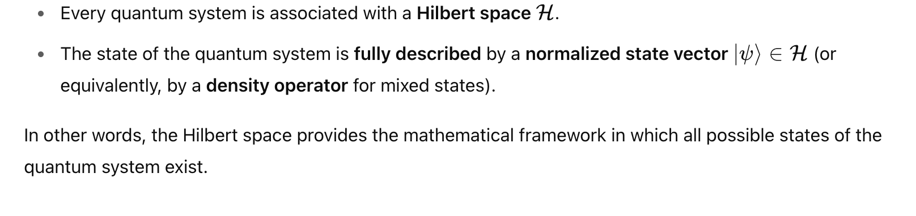
Postulates of Quantum Mechanics
Postulate 1 - State Space

Slide 16
Postulates of Quantum Mechanics
Postulate 2 - Time Evolution

Slide 17
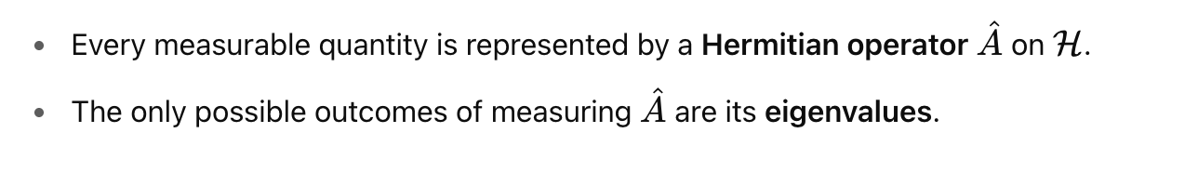
Postulates of Quantum Mechanics
Postulate 3 - Observables

Slide 18
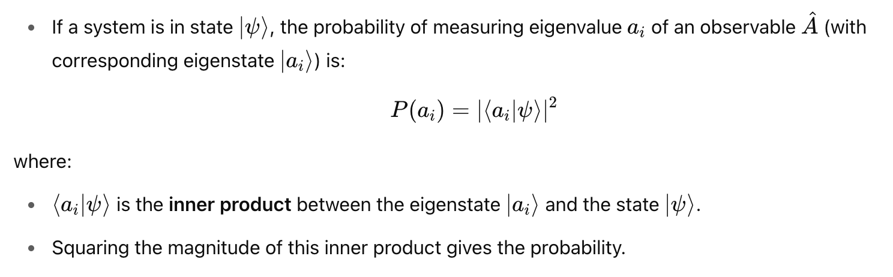
Postulates of Quantum Mechanics
Postulate 4 - Born Rule

Slide 19
Postulates of Quantum Mechanics
Postulate 5 - Wave Function Collapse

Slide 20
Postulates of Quantum Mechanics
Postulates 1 and 2 describe state space and deterministic evolution.
Postulate 3, 4, and 5 describe the measurement process (observables, probabilities, and collapse).

Slide 21
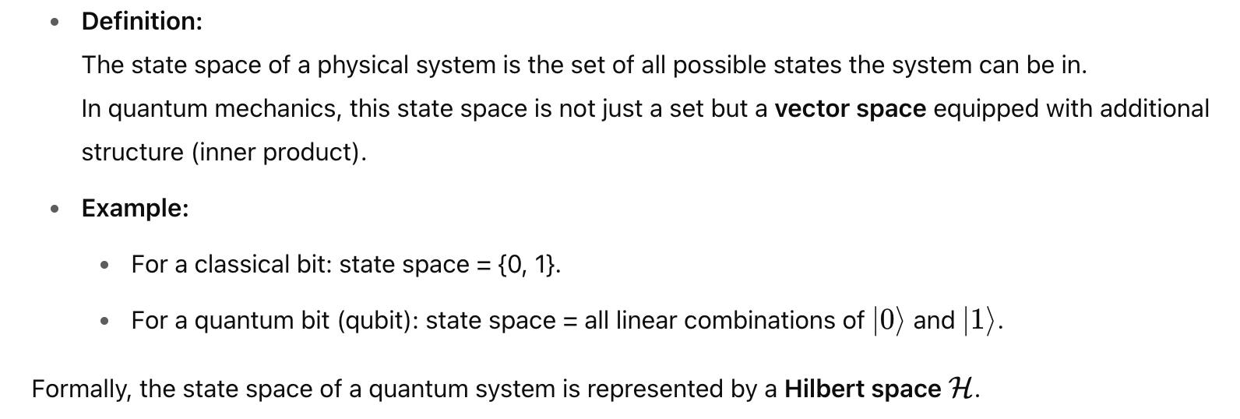
State Space

Slide 22
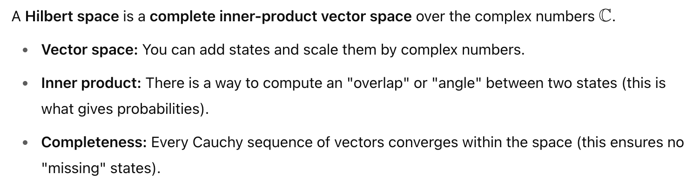
Hilbert Space

Slide 23
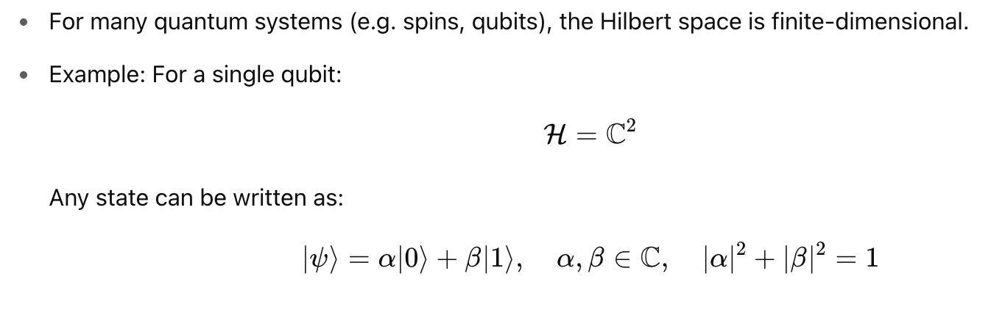
Finite Dimensional Hilbert Space

Slide 24
Infinite Dimensional Hilbert Space

Slide 25
Unitary Operator

Slide 26
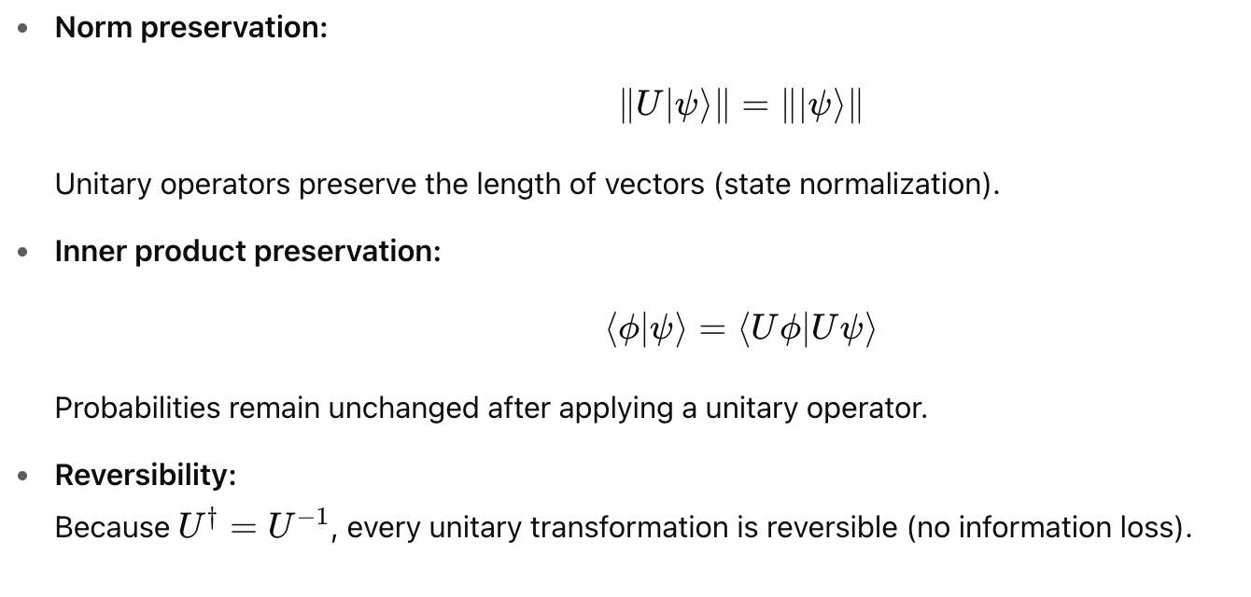
Key Properties of Unitary Operator

Slide 27
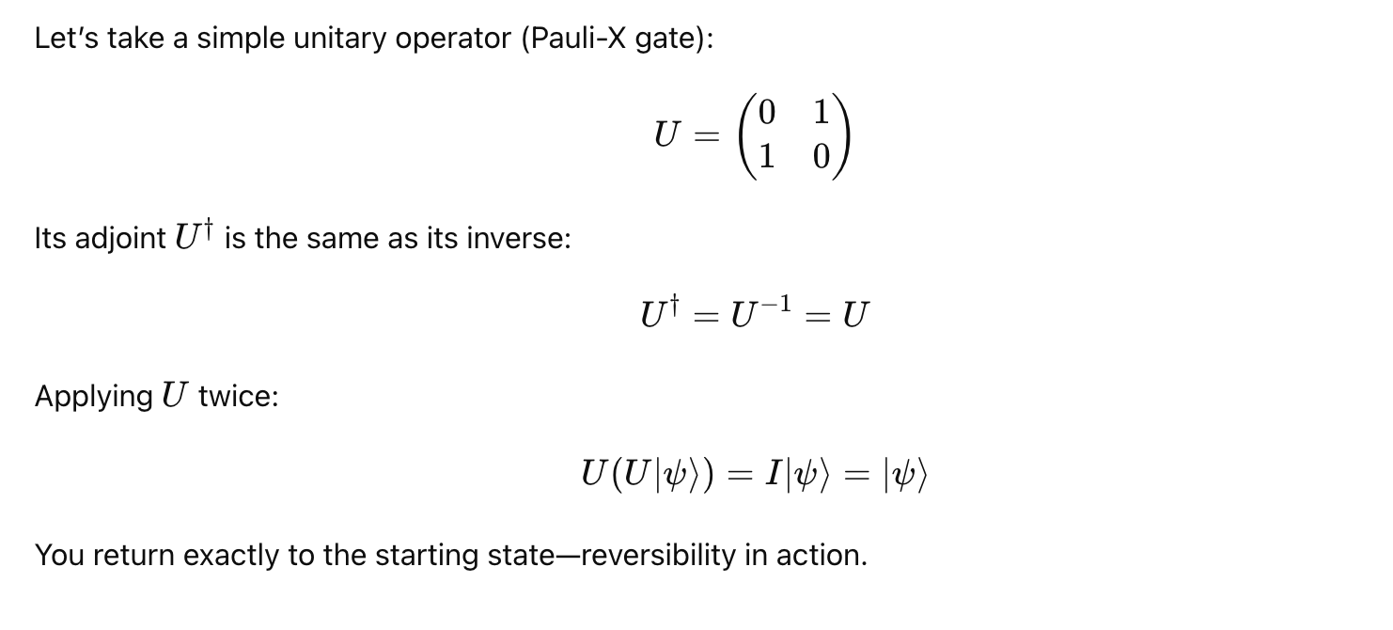
Example of an Unitary Operator

Slide 28
Why Unitary is Important

Slide 29
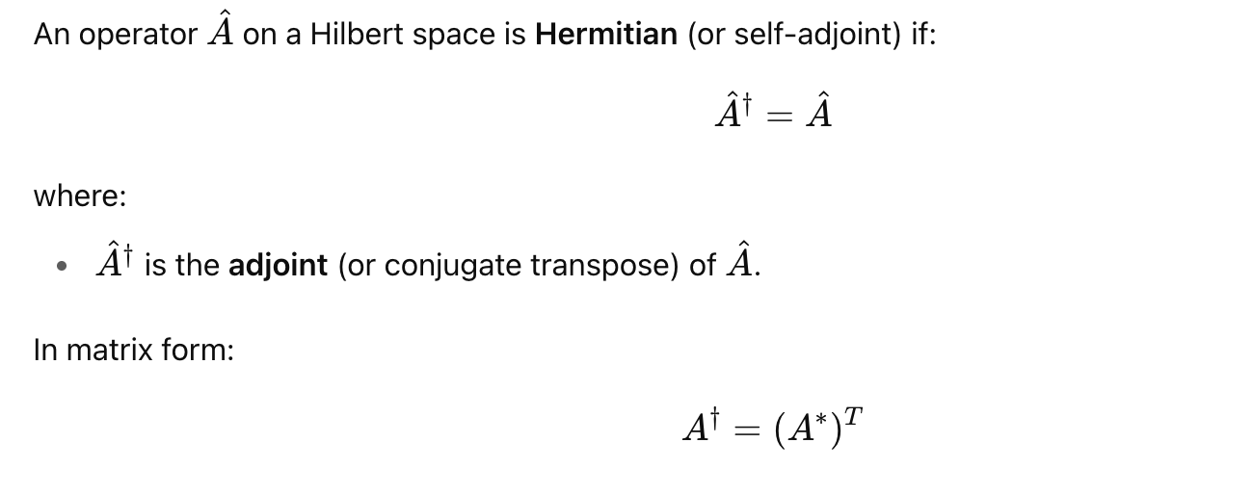
Hermitian Operator

Slide 30
Adjoint of an Operator

Slide 31
Adjoint in Matrix Form

Slide 32
Eigenvector and Eigenvalue

Slide 33
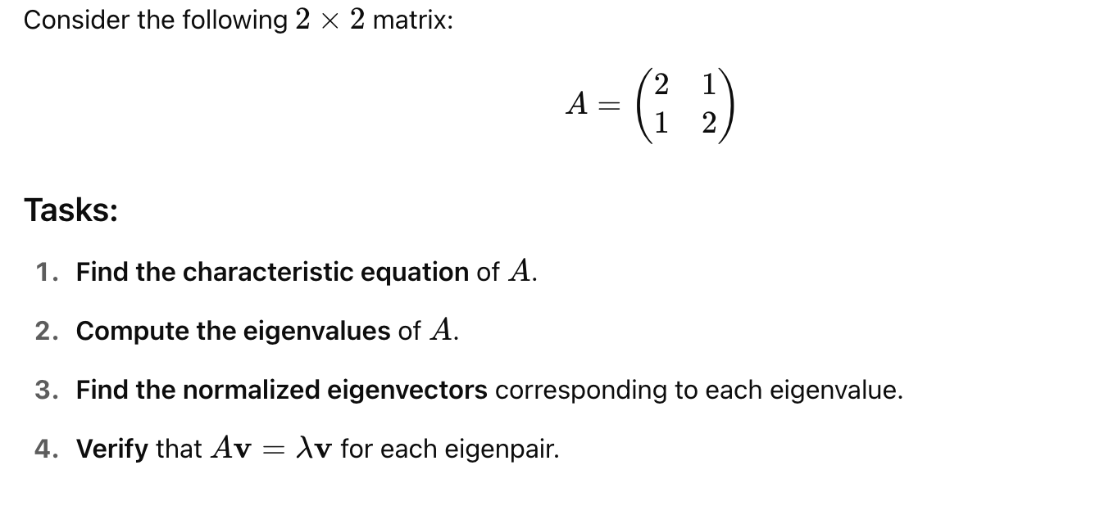
Exercise: Eigenvalues and Eigenvectors

Slide 34
Step 1: Solve Characteristics Equation

Slide 35
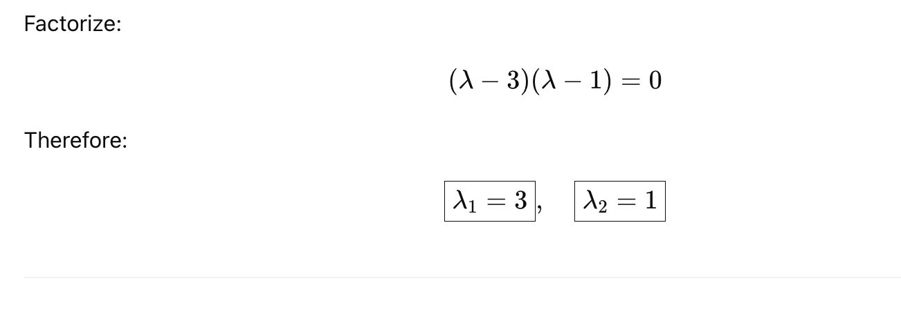
Step 2: Solve for Eigenvalues

Slide 36
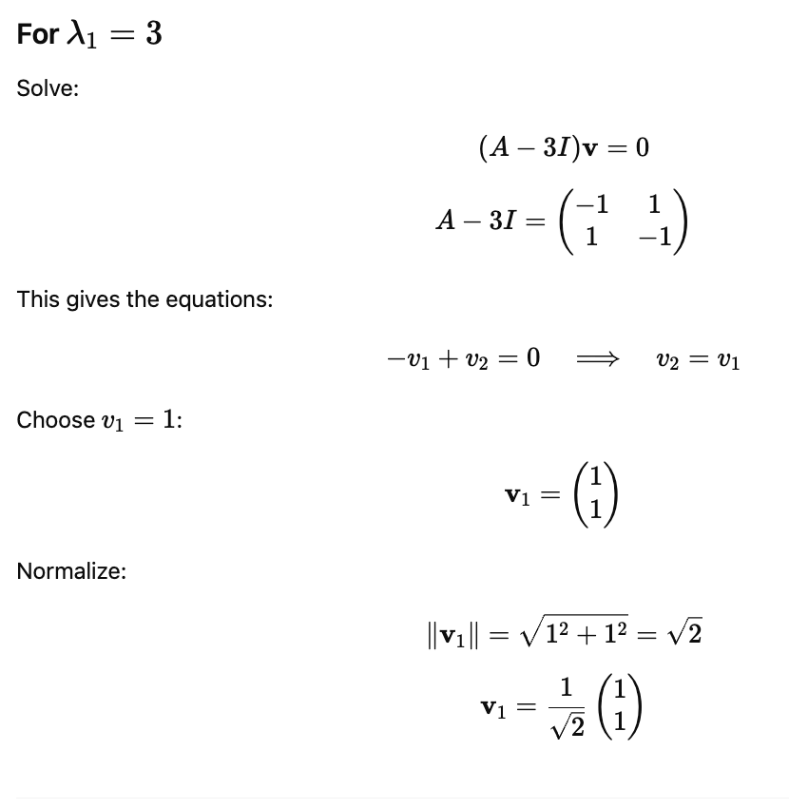
Step 3: Find Eigenvectors

Slide 37
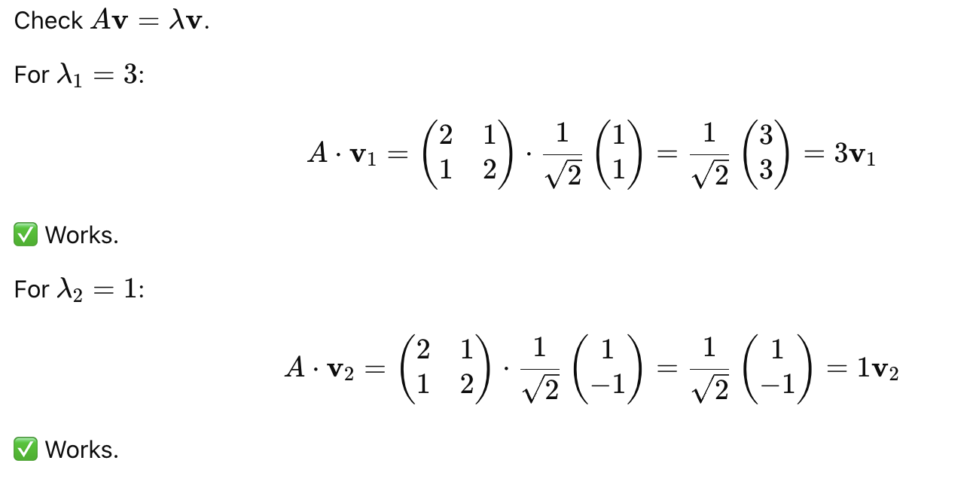
Step 4: Verification

Slide 38
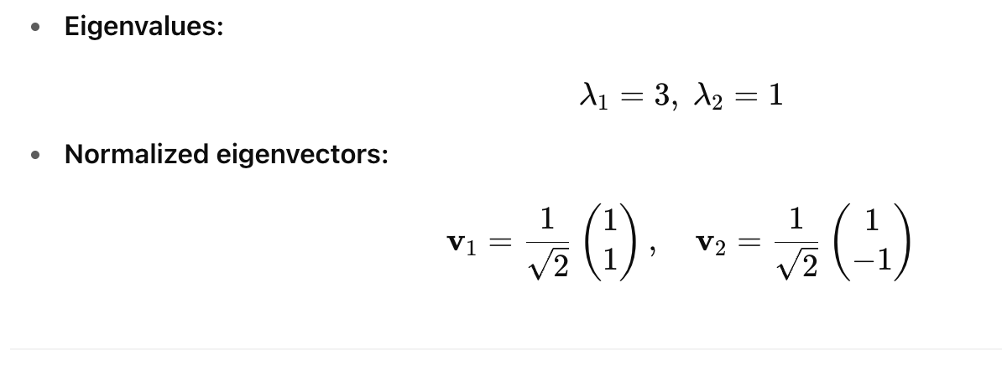
Final Answer

Slide 39
Key Properties of a Hermitian Operator

Slide 40
Hermitian Operators in QM

Slide 41
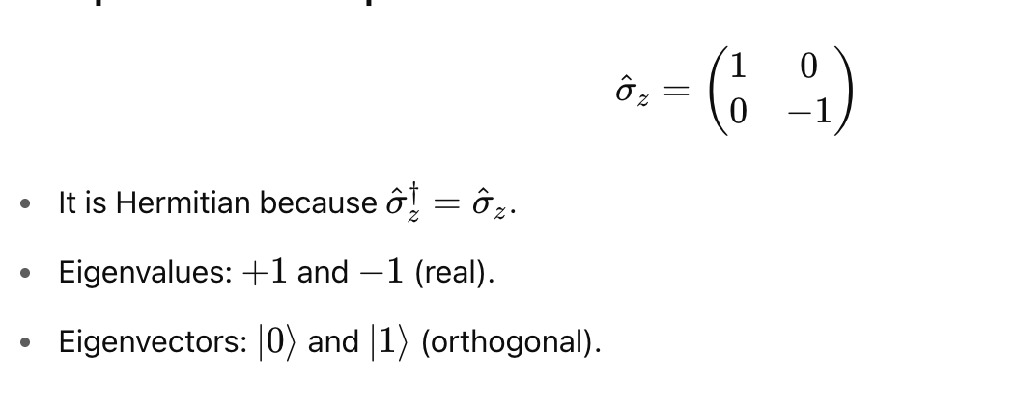

Example of Hermitian Operator

Slide 42
Dirac Notation
Dirac notation (also called bra–ket notation) is a compact and powerful way to describe quantum states and operations in quantum mechanics.
It was introduced by Paul Dirac and is used to express vectors, inner products, and linear operators in Hilbert space.

Slide 43
Dirac Notation
Dirac notation (also called bra–ket notation) is a compact and powerful way to describe quantum states and operations in quantum mechanics.
It was introduced by Paul Dirac and is used to express vectors, inner products, and linear operators in Hilbert space.

Slide 44
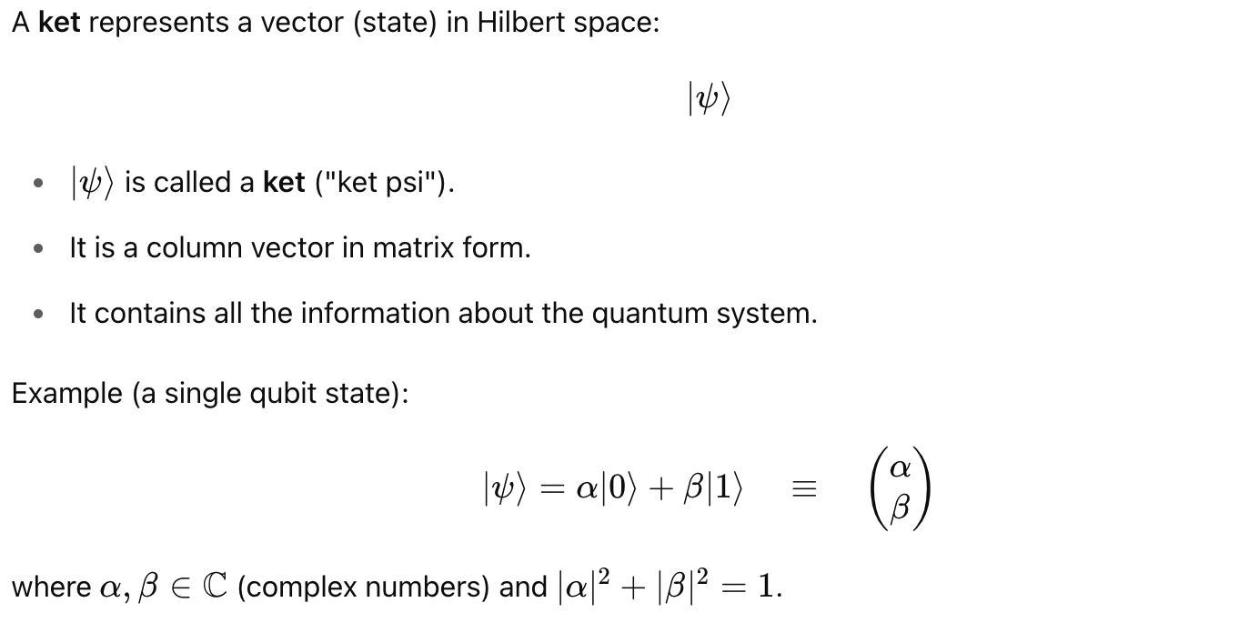
Quantum States as Kets

Slide 45
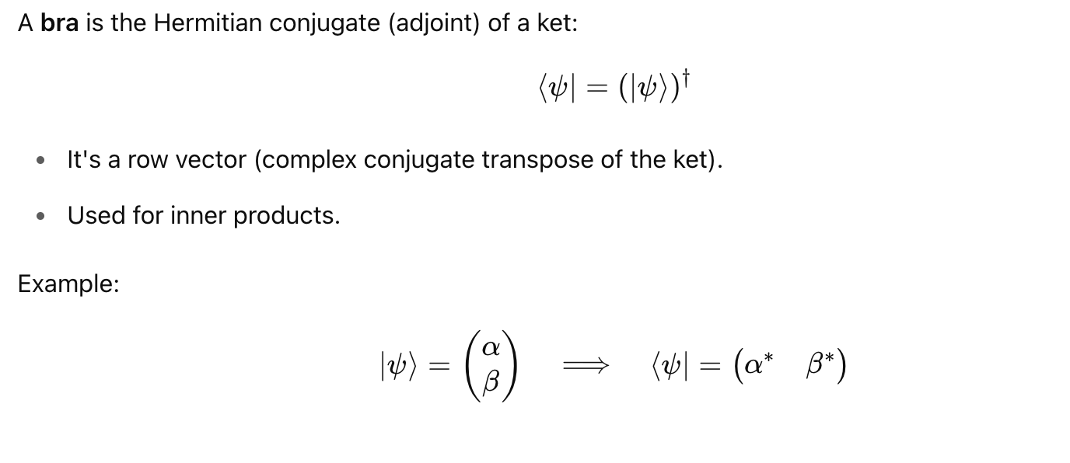
Bras (Dual Vectors)

Slide 46
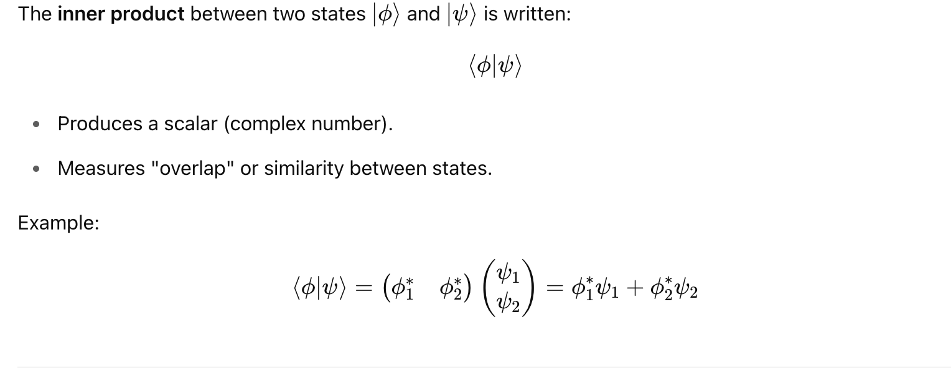
Inner Products (Bra-Ket)

Slide 47
Outer Products (Ket-Bra)

Slide 48
Pauli-X Gate in Dirac Notation

Slide 49
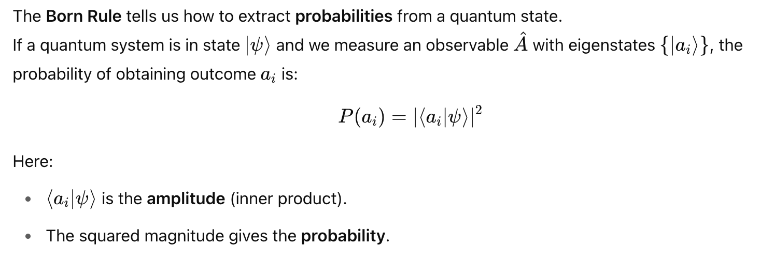
Born Rule in Dirac Notation

Slide 50
Exercise: Born Rule

Slide 51
Step 1: Compute Amplitude

Slide 52
Step 2: Apply Born Rule

Slide 53
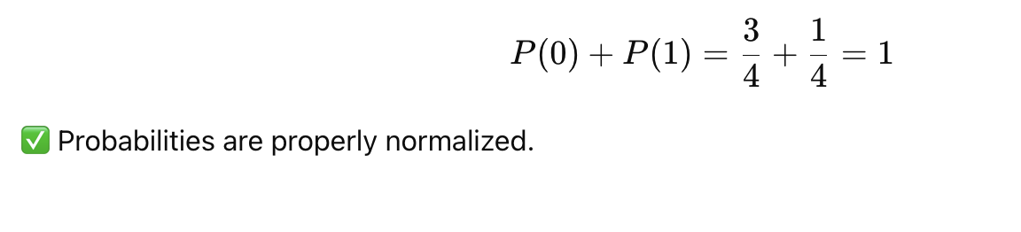
Step 3: Verify Normalization

Slide 54
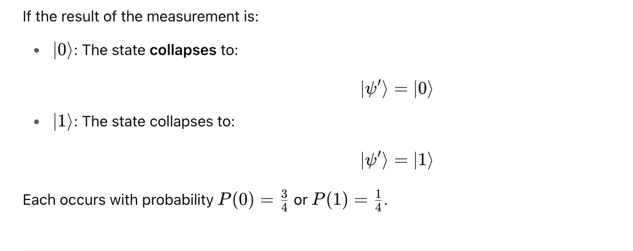
Step 4: Post Measurement State

Slide 55
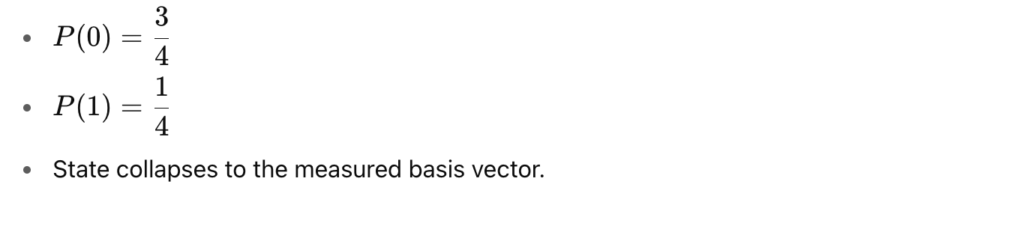
Final Answer

Slide 56
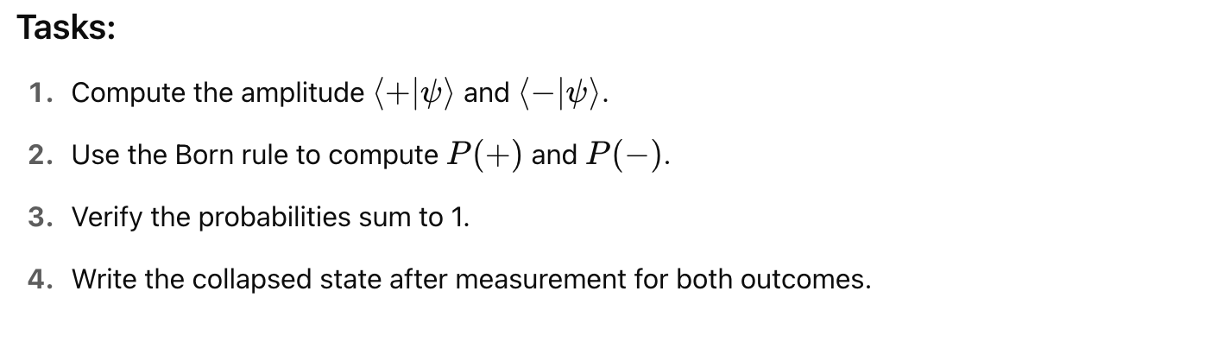
Exercise 2: Born Rule

Slide 57
Step 1: Compute Amplitudes

Slide 58
Step 1: Compute Amplitudes

Slide 59
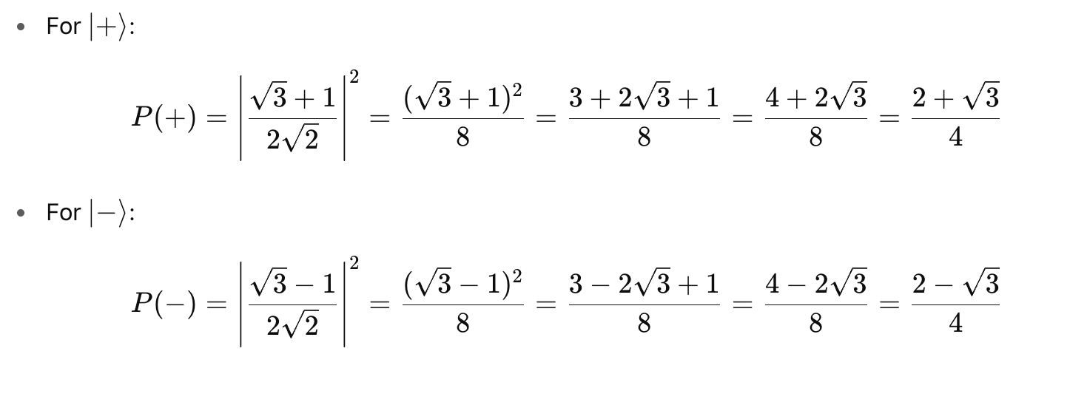
Step 2: Apply Born Rule

Slide 60
Step 3: Verify Normalization

Slide 61
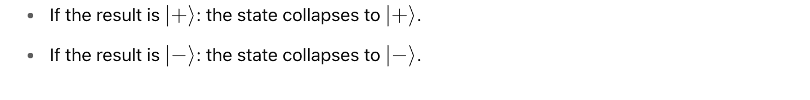
Step 4: Post Measurement State

Slide 62
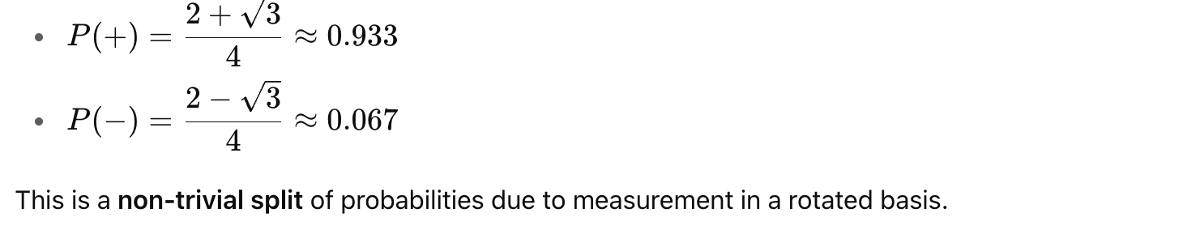
Final Answer

Slide 63
Tensor Product of State Vectors

Slide 64
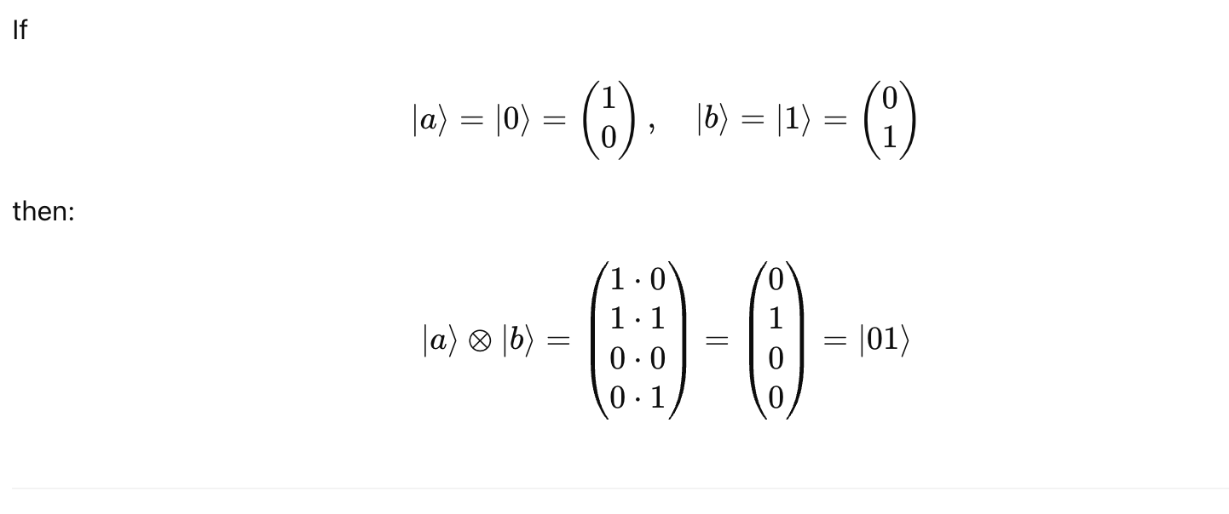
Example of Tensor Product for States

Slide 65
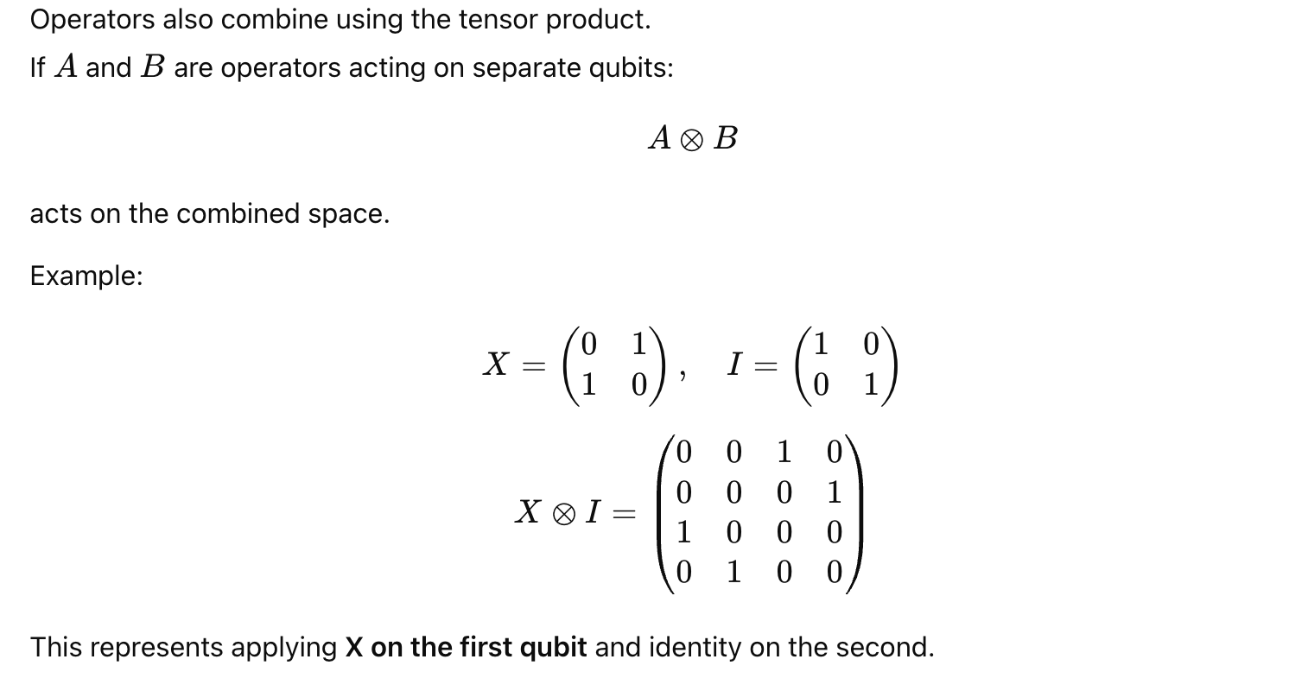
Tensor Product for Operators

Slide 66
Key Properties of Tensor Product

Slide 67
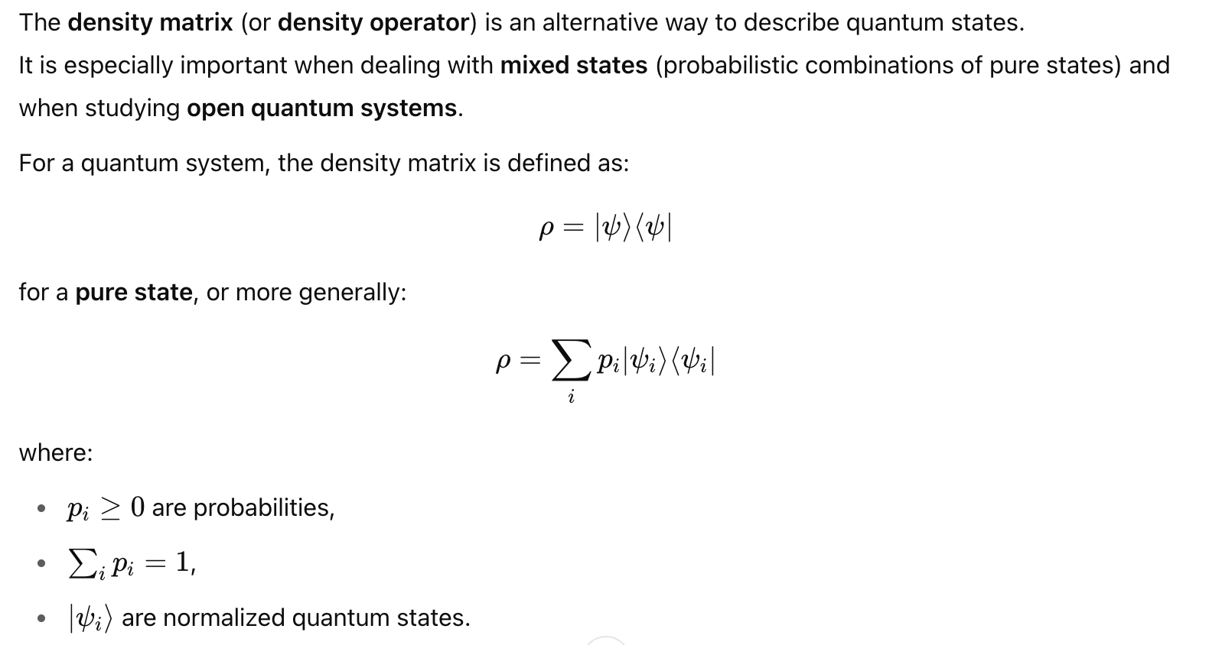
Density Matrix

Slide 68
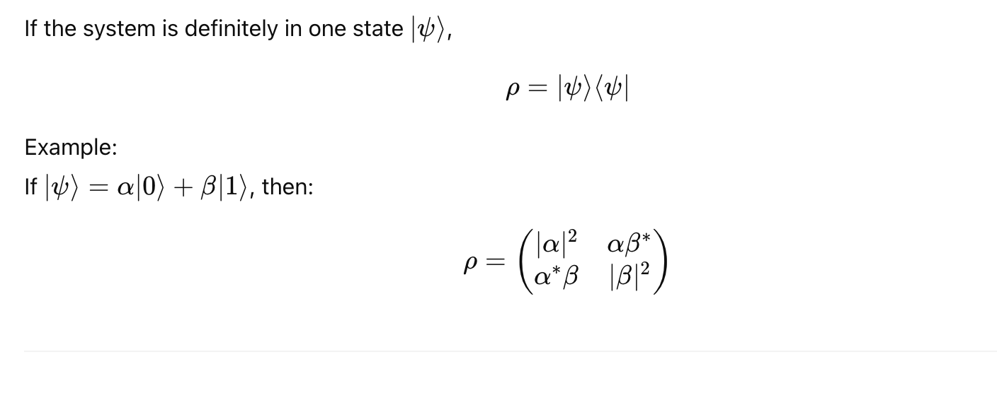
Density Matrix of Pure State

Slide 69
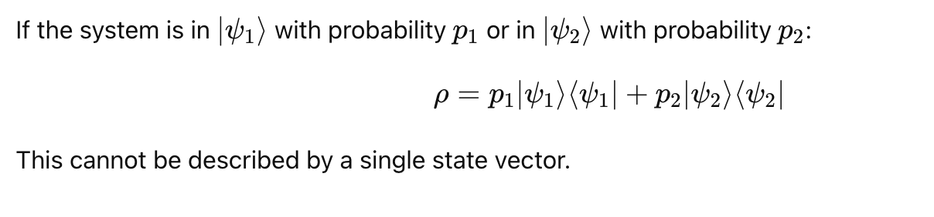
Density Matrix of Mixed State

Slide 70
Properties of Density Matrix

Slide 71
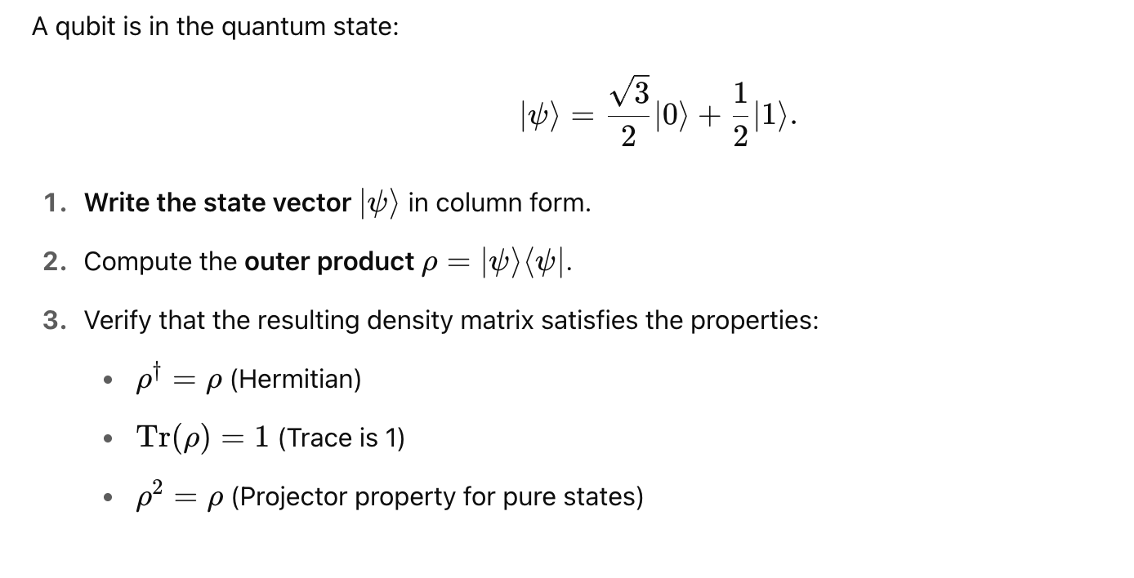
Exercise: Density Matrix for Pure State

Slide 72
Solution: Density Matrix for Pure State

Slide 73
Solution: Density Matrix for Pure State

Slide 74
Exercise: Density Matrix for Mixed State

Slide 75
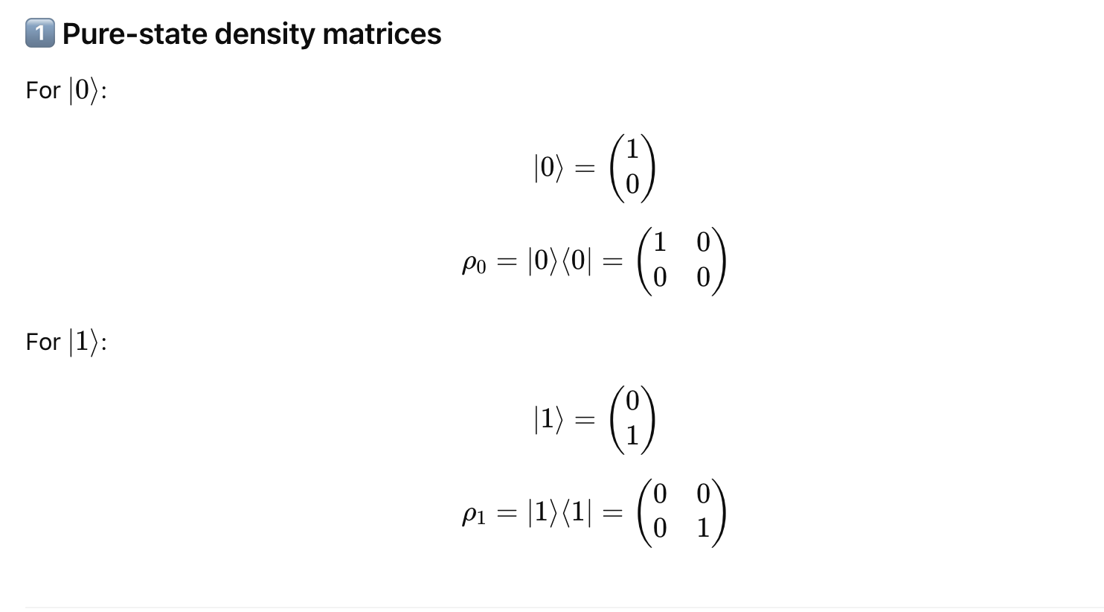
Solution: Density Matrix for Mixed State

Slide 76
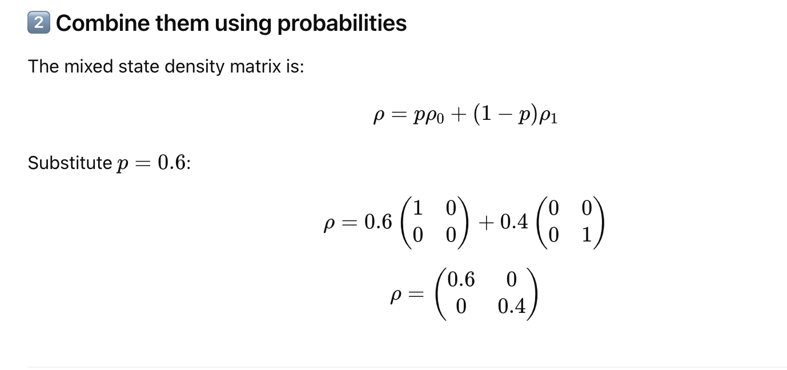
Solution: Density Matrix for Mixed State

Slide 77
Solution: Density Matrix for Mixed State

Slide 78
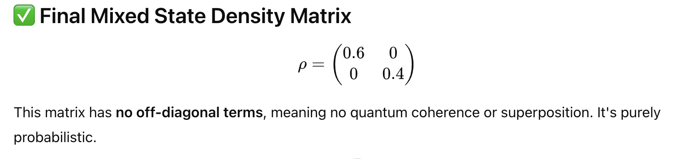
Solution: Density Matrix for Mixed State

Slide 79
Decoherence
Decoherence is the process by which a quantum system loses its quantum properties (like superposition and entanglement) due to interaction with its environment. When this happens, the quantum state begins to behave more like a classical probabilistic mixture rather than a pure quantum state.

Slide 80
Decoherence

Slide 81
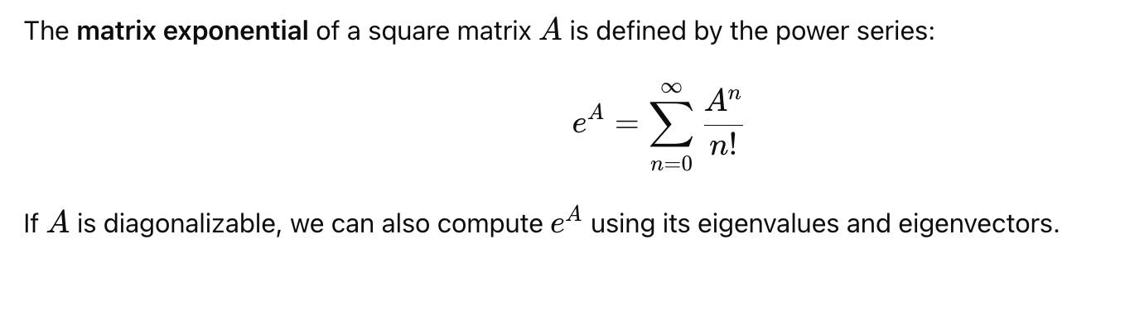
Matrix Exponential

Slide 82
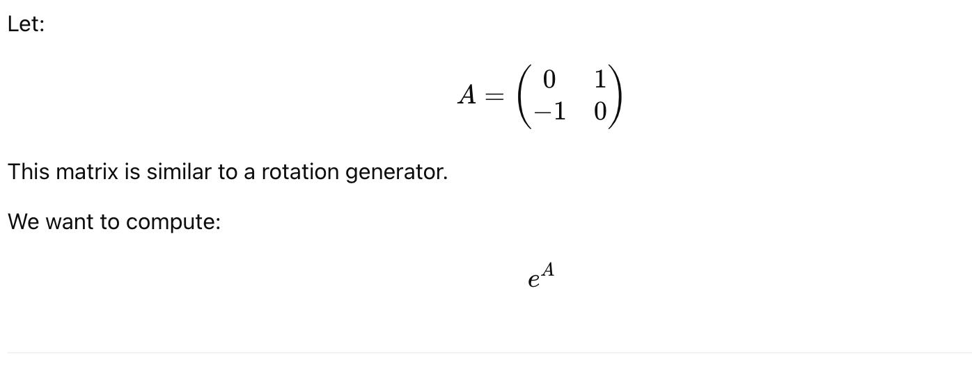
Example 1 of Matrix Exponential

Slide 83
Example 1 of Matrix Exponential

Slide 84
Example 1 of Matrix Exponential

Slide 85
Example 1 of Matrix Exponential

Slide 86
Example 1 of Matrix Exponential

Slide 87
Example 2 of Matrix Exponential

Slide 88
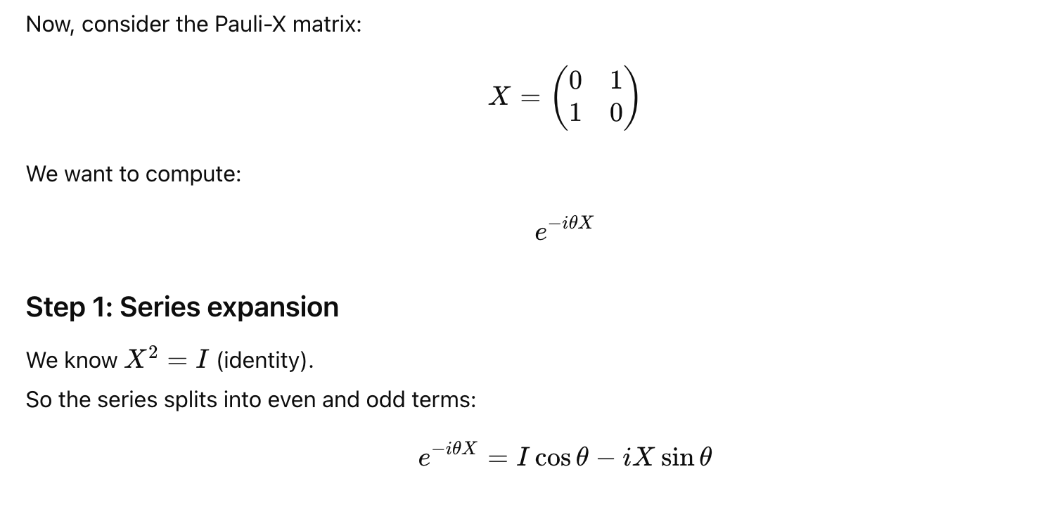
Example 3 of Matrix Exponential

Slide 89
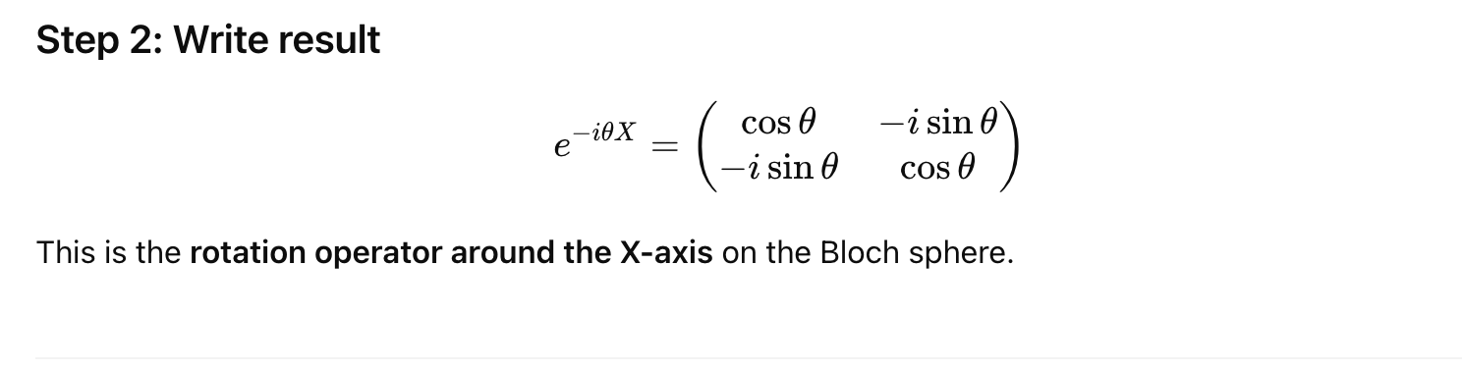
Example 3 of Matrix Exponential

Slide 90
Labs
Try out the labs at
https://colab.research.google.com/drive/1m3NOI2q4W4LHuP9-UdpbfRmBgflUbapa?usp=sharing

Slide 91
Topic 2
Introduction to Quantum Computing Systems

Slide 92
What is a Quantum Computer
A quantum computer is a machine that performs calculations on qubits based on two laws in the quantum mechanical world: superposition and entanglement.

Slide 93
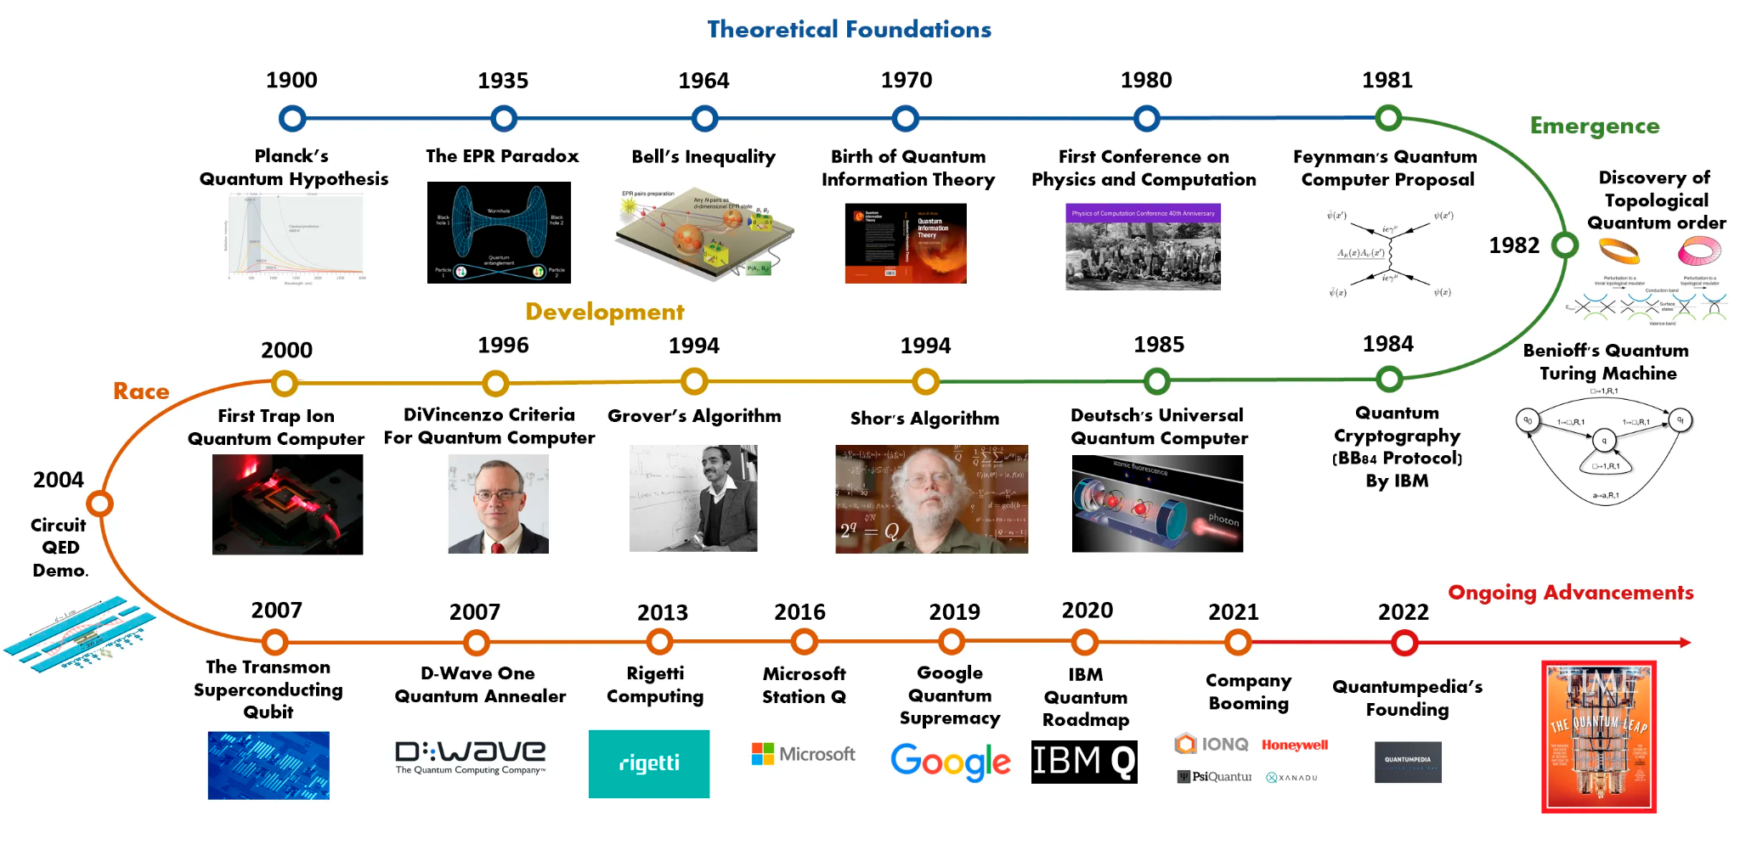
Brief History of Quantum Computing

Slide 94
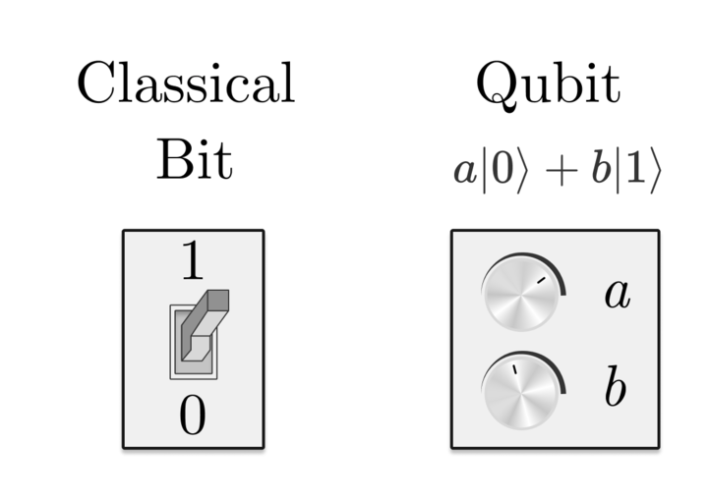
What is Qubit
A qubit is the quantum version of a bit, and its quantum state can take values of |0>, |1>, or both at once, a phenomenon known as superposition
Classical bit is either 1 or 0. A single qubit is a superposition of |0> and |1>.

Slide 95
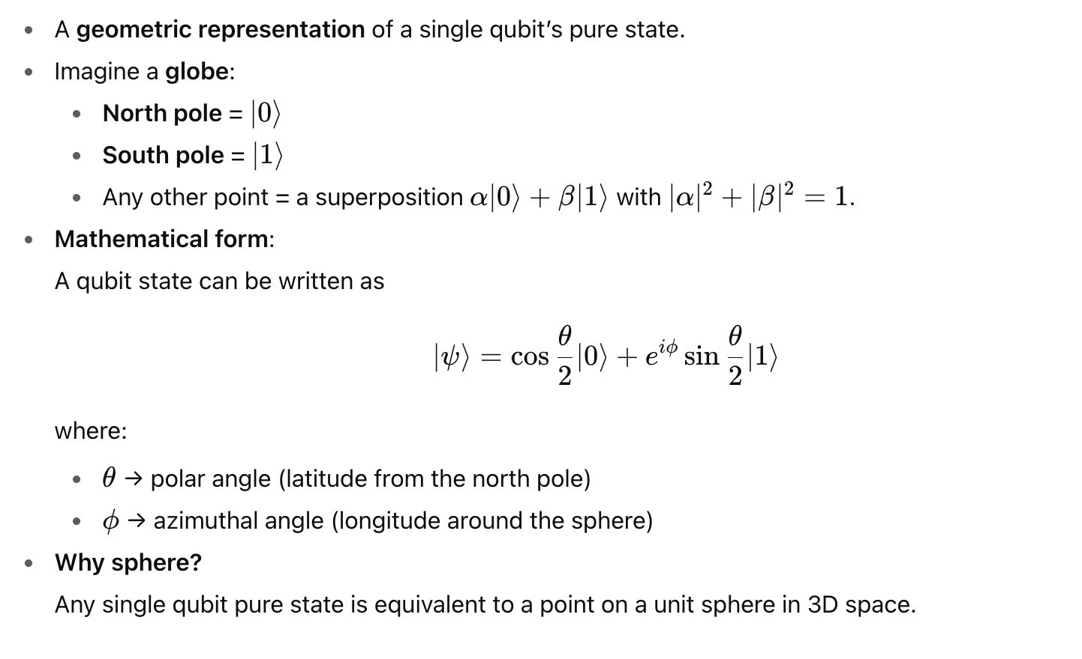
Visualize Qubit in Bloch Sphere

Slide 96
Lab - Bloch Sphere
Try out the Bloch Sphere at https://bloch.kherb.io/

Slide 97
Physical Implementation of Qubit
Any two-level quantum-mechanical system can be used as a qubit.
The following is an incomplete list of physical implementations of qubit
  Optical (Photonic) Qubit
  Superconducting Qubit (Josephson Junction)
  Trapped Ion Qubit
  Topological Qubit
  ….

Slide 98
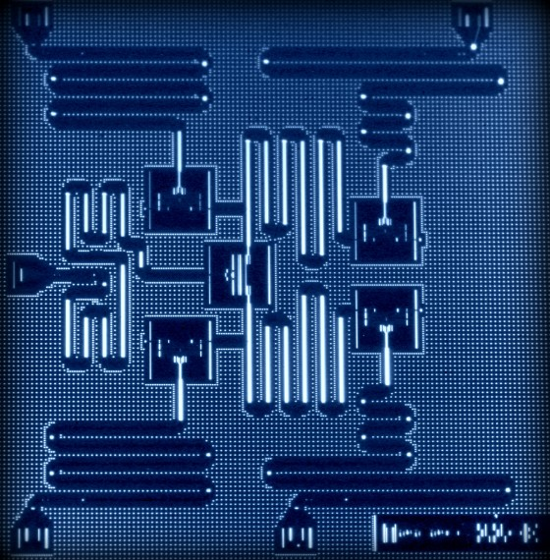
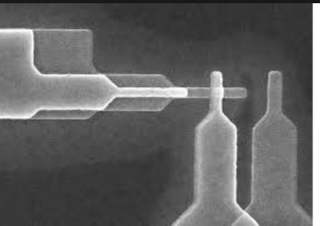
Josephson Junction Qubit

Slide 99
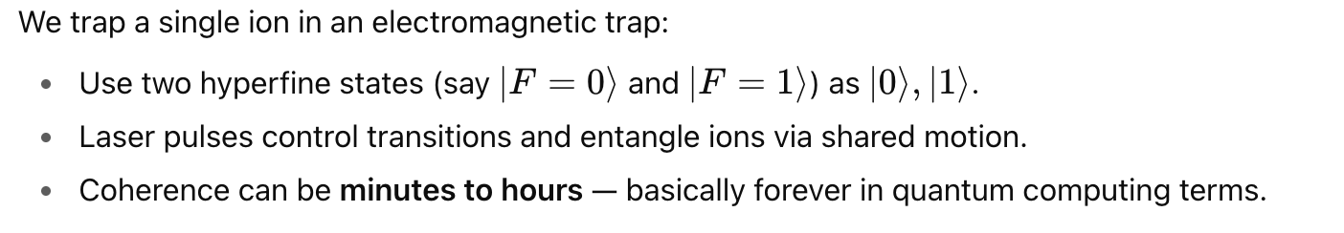
Trapped Ion Qubit

Slide 100
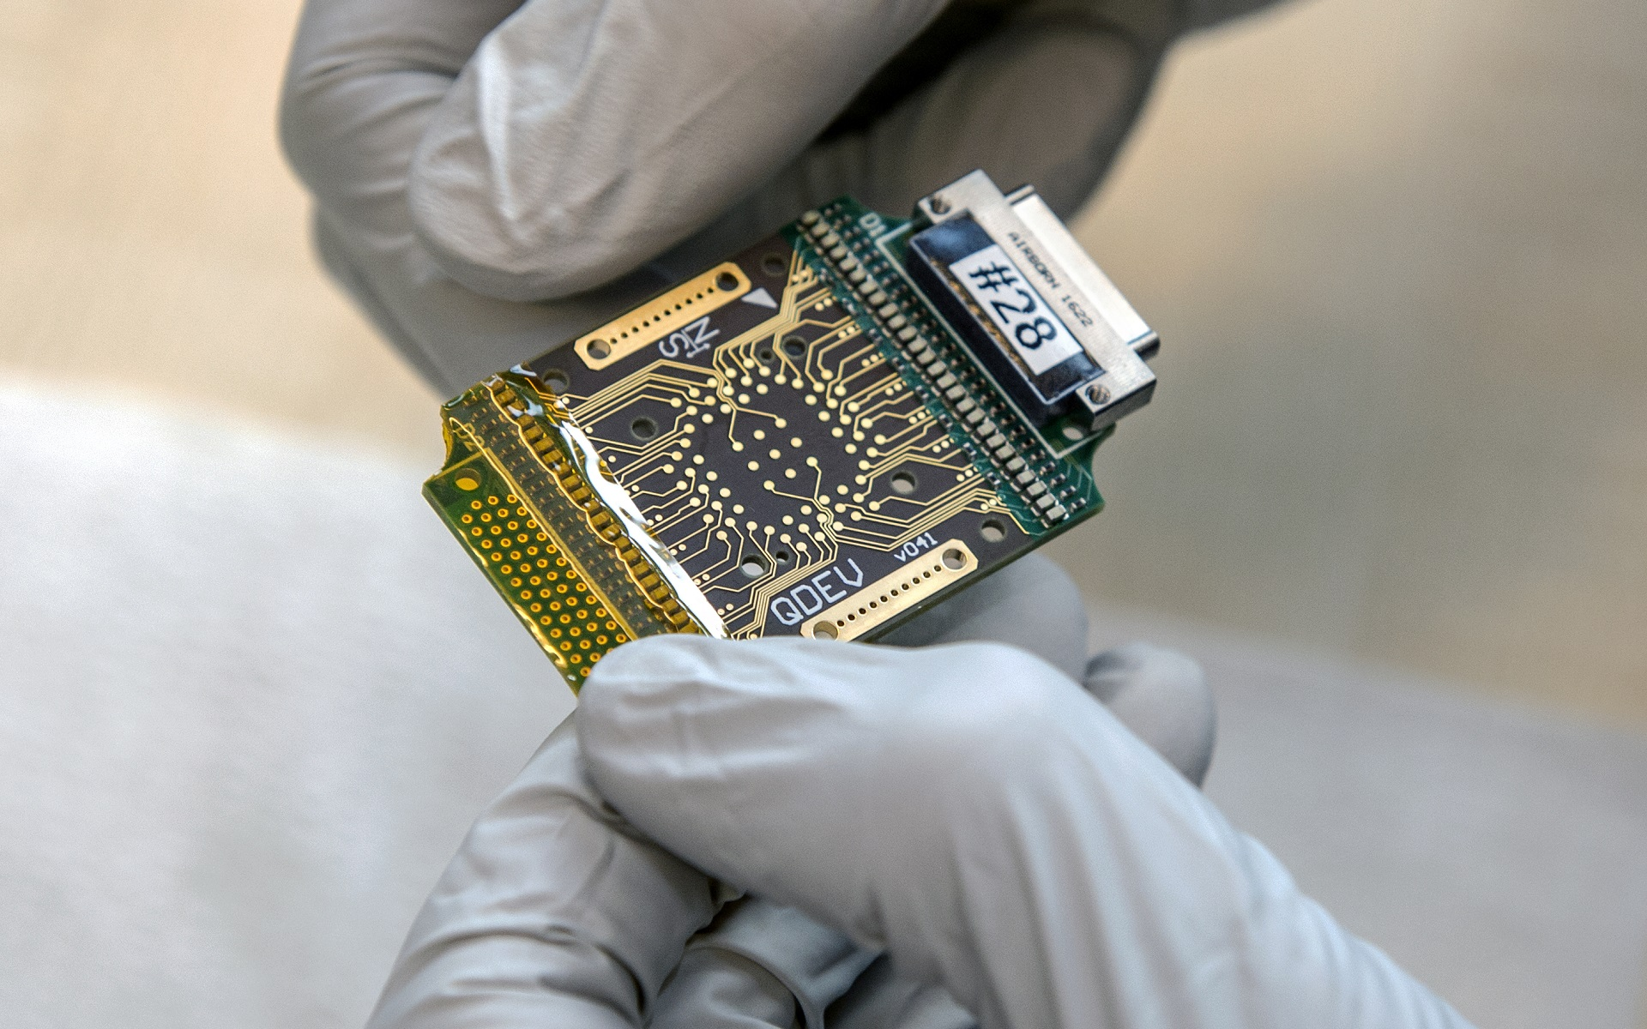
Topological Qubit

Slide 101
IBM Quantum Computers

Slide 102

Use Cases of Quantum

Slide 103
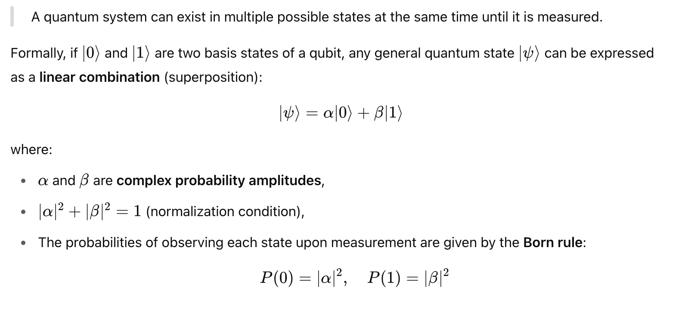
Quantum Superposition

Slide 104
Quantum Interference Demo
https://lab.quantumflytrap.com/lab/measurement-destroys-interference

Slide 105
Quantum Entanglement
Quantum entanglement is a phenomenon in quantum mechanics where two or more particles become linked in such a way that their quantum states cannot be described independently, even if the particles are separated by large distances.
In an entangled system, measuring one particle instantaneously affects the state of the other, regardless of the distance between them—this is what Einstein famously referred to as “spooky action at a distance.”

Slide 106
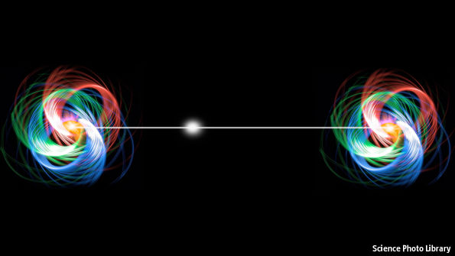
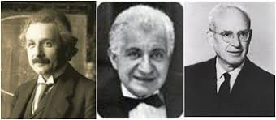
EPR Paradox
"Spooky Action at a Distance"
- Albert Einstein
The Einstein–Podolsky–Rosen paradox (EPR paradox) is a thought experiment proposed by physicists Albert Einstein, Boris Podolsky and Nathan Rosen (EPR), with which they argued that the description of physical reality provided by quantum mechanics was incomplete

Slide 107
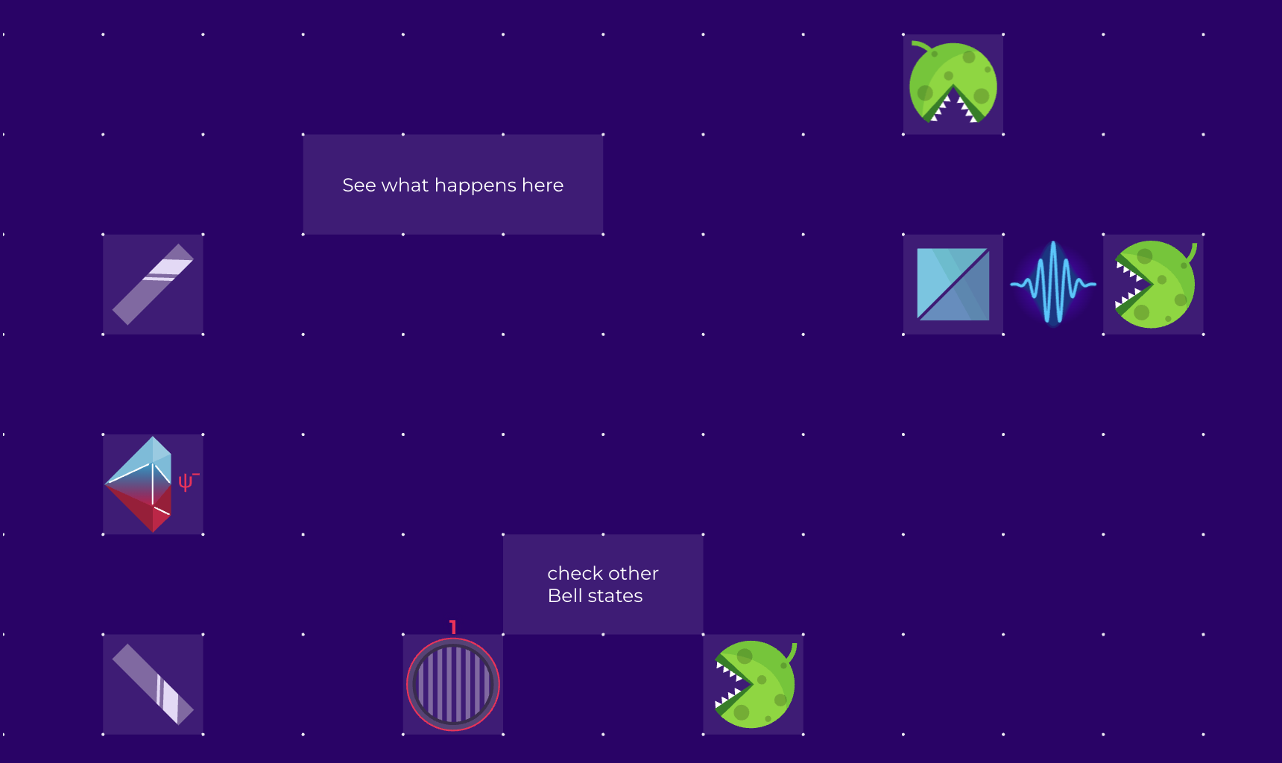
Quantum Entanglement Demo
https://lab.quantumflytrap.com/lab/spooky-action-at-a-distance

Slide 108
Example of Entangled State

Slide 109

Separability Condition for Entanglement

Slide 110
Separability Condition for Entanglement

Slide 111
Separability Condition for Entanglement

Slide 112
Separability Condition for Entanglement

Slide 113
Topic 3
Quantum Gates and Circuits

Slide 114
Visual Quantum Gate Simulators
https://thequantumlaend.de/quantum-circuit-designer/
https://quantum.cloud.ibm.com/composer
https://algassert.com/quirk

Slide 115


Pauli X Gate

Slide 116

Pauli X Gate

Slide 117
Pauli X Gate

Slide 118


Pauli Y Gate

Slide 119

Pauli Y Gate

Slide 120
Pauli Y Gate

Slide 121
Pauli Z Gate

Slide 122

Pauli Z Gate

Slide 123

Pauli Z Gate

Slide 124


Key Properties of Pauli Gates

Slide 125

Key Properties of Pauli Gates

Slide 126

Key Properties of Pauli Gates

Slide 127

Key Properties of Pauli Gates

Slide 128
Lab - IBM Quantum Composer
Try out the logic gates at IBM Quantum Composer
https://quantum.cloud.ibm.com/composer

Slide 129
Rotation Gates

Slide 130

Rotation Gates Action on States

Slide 131
Rotation Gates Action on States

Slide 132

Phase Gate

Slide 133

Special Cases of Phase Gate

Slide 134
Special Cases of Phase Gate

Slide 135
Key Properties of Rotation Gates

Slide 136

Hadamard Gate

Slide 137
Key Properties of Hadamard Gate

Slide 138
Hadamard Gate

Slide 139

CNOT Gate

Slide 140
CNOT Gate Actions on States

Slide 141

CNOT Gate

Slide 142
Key Properties of CNOT Gate

Slide 143
Eigenvalues and Eigenvectors of CNOT

Slide 144

Eigenvalues and Eigenvectors of CNOT

Slide 145

Eigenvalues and Eigenvectors of CNOT

Slide 146
Eigenvalues and Eigenvectors of CNOT

Slide 147
Eigenvalues and Eigenvectors of CNOT

Slide 148

CZ Gate

Slide 149

CZ Gate Action on State

Slide 150

CZ Gate Action on State

Slide 151

Key Properties of CZ Gate

Slide 152
Controlled Phase Gate

Slide 153

Controlled Phase Gate

Slide 154
Controlled Phase Gate

Slide 155

SWAP Gate

Slide 156
SWAP Gate

Slide 157

SWAP Gate Action on State

Slide 158
Key Properties of SWAP Gate

Slide 159

Toffoli Gate (CCNOT Gate)

Slide 160
Toffoli Gate (CCNOT Gate)

Slide 161

Toffoli Gate (CCNOT Gate)

Slide 162
Toffoli Gate (CCNOT Gate)
The Toffoli gate, also known as the CCNOT (Controlled-Controlled-NOT) gate, is a 3-qubit quantum gate that applies an X (NOT) operation on the target qubit only if both control qubits are in the state
It is universal for reversible classical computation and is also used in quantum error correction and arithmetic circuits.

Slide 163

Pennylane

Slide 164
What is PennyLane?
PennyLane is an open-source Python library that allows us to build and simulate quantum and hybrid algorithms.
It allows us to run the algorithms locally in our CPUs, or externally in various GPUs, quantum simulators, and quantum devices.
Although it was initially developed for quantum machine learning applications, it has since developed to run algorithms for a wide array of areas in quantum computing research.
PennyLane is a community. Everyone can contribute to its growth and development.

Slide 165

Quantum Function
A quantum circuit, or quantum function, is a Python function that contains a list of gates that may depend on some parameters and act on some wires, i.e. qubits. In PennyLane, all wires are initialized in the state
This function will apply the gate gate1 followed by gate2.

Slide 166


Quantum Function

Slide 167

Return Quantum State
To run my_first_quantum_function, we need to return something. One of the return types that PennyLane accepts is qml.state(), which returns a complex np.array that represents the quantum state after all the gates have been applied

Slide 168
Quantum Device
In PennyLane, we need to specify a device on which the quantum circuit will run.
default.qubit: Vanilla qubit quantum device, for circuits without noise. It is not optimized for performance, but it's the first one to be upgraded and will have the most advanced features at any point in time.
lightning.qubit: A fast noiseless qubit device. It is optimized for performance via a C++ backend, but its development will often lag a bit behind default.qubit.
default.mixed: A qubit device that allows noisy gates. It works with the density operator representation of quantum states.

Slide 169
Quantum Node
The pairing of a quantum circuit with a device is called a QNode.

Slide 170
Quantum Node
If we want to distinguish the function from the QNode, we can use the qml.QNode function as follows.

Slide 171
Measurement
PennyLane can extract different types of measurement results from quantum devices: the expectation of an observable, its variance, samples of a single measurement, or computational basis state probabilities.
Notes:
https://docs.pennylane.ai/en/stable/introduction/measurements.html

Slide 172
Print the Circuit
To view the quantum circuit given specific parameter values, we can use the draw() transform,
Notes:
https://docs.pennylane.ai/en/stable/introduction/circuits.html

Slide 173

Draw the Circuit
To view the quantum circuit given specific parameter values, we can use the the draw_mpl() transform:
Notes:
https://docs.pennylane.ai/en/stable/introduction/circuits.html

Slide 174

Name the Wires

Slide 175
Lab - Pennylane
Try out the pennylane exercises at
https://pennylane.ai/codebook/pennylane-fundamentals/circuits-and-qnodes

Slide 176

Bell State

Slide 177

How to Create Bell State

Slide 178

Key Properties of Bell State

Slide 179
Measurement Correlation

Slide 180
GHZ State

Slide 181
How to Create a GHZ State

Slide 182

Key Properties of GHZ State

Slide 183

Generalization to n Qubits

Slide 184
Quantum Circuit

Slide 185
Phase Kickback
Phase kickback is a phenomenon in quantum computing where a phase applied to a target qubit during a controlled operation (like a controlled-U gate) "kicks back" and affects the control qubit instead.
This effect is crucial in many quantum algorithms, including Quantum Phase Estimation (QPE) and Shor’s algorithm, because it allows us to transfer information about a phase from one qubit to another.

Slide 186
Phase Kickback

Slide 187
Example of Phase Kickback

Slide 188
Lab - Logic Gates
Try out the various logic gate with Pennylane at
https://colab.research.google.com/drive/1m3NOI2q4W4LHuP9-UdpbfRmBgflUbapa?usp=sharing

Slide 189
Topic 4
Quantum Protocols

Slide 190
No-Cloning Theorem
It is impossible to create an identical copy of an arbitrary unknown quantum state.
Quantum states cannot be cloned if they are arbitrary and unknown.
Cloning is only possible for orthogonal states because orthogonal states can be distinguished perfectly, allowing classical copying.
This principle is crucial for quantum cryptography, quantum communication, and explains why quantum information behaves very differently from classical information.

Slide 191

No-Cloning Theorem

Slide 192
Proof of No-Cloning Theorem

Slide 193

Proof of No-Cloning Theorem

Slide 194

Proof of No-Cloning Theorem

Slide 195
Quantum Teleportation
Alice has a qubit Q that she wishes to transmit to Bob.
Alice is unable to physically send Q to Bob — she is only able to send classical information.
Alice and Bob share an entangled bit.
The state of Q is “unknown” to both Alice and Bob.
The no-cloning theorem implies that if Bob receives the transmission, Alice must no longer have the qubit in its original state

Slide 196
Quantum Teleportation

Slide 197
Quantum Teleportation

Slide 198

Quantum Teleportation

Slide 199
Quantum Teleportation

Slide 200
Quantum Teleportation

Slide 201
Quantum Teleportation

Slide 202
Lab - Quantum Teleportation
Try out Quantum Teleportation on IBM Quantum Composer
https://quantum.cloud.ibm.com/composer

Slide 203
Lab - Quantum Teleportation
Try out Quantum Teleportation codes on
https://colab.research.google.com/drive/1m3NOI2q4W4LHuP9-UdpbfRmBgflUbapa?usp=sharing

Slide 204
Quantum Teleportation
Teleportation is not an application of quantum information — it’s a way to perform quantum communication.
Teleportation motivates entanglement distillation as a means to reliable quantum communication.
Beyond its potential for communication, teleportation also has fundamental importance in the study of quantum information and computation.

Slide 205
Superdense Coding Protocol
Alice has two classical bits that she wishes to transmit to Bob.
Alice is able to send a single qubit to Bob.
Alice and Bob share an entangled bit.
Without the entangled bit, Alice and Bob’s task would be impossible.
Holevo’s theorem implies that two classical bits of communication cannot be reliably transmitted by a single qubit alone

Slide 206

Superdense Coding Protocol

Slide 207

Superdense Coding Protocol

Slide 208
Superdense Coding Protocol
Superdense coding seems unlikely to be useful in a practical sense.
The underlying idea is fundamentally important, and illustrates an interesting aspect of entanglement.
Together with teleportation, superdense coding establishes an equivalence

Slide 209
Lab - Superdense Coding Protocol
Try out Superdense Coding Protocol on IBM Quantum Composer
https://quantum.cloud.ibm.com/composer

Slide 210
Lab - Superdense Coding Protocol
Try out Superdense Coding Protocol codes on
https://colab.research.google.com/drive/1m3NOI2q4W4LHuP9-UdpbfRmBgflUbapa?usp=sharing

Slide 211
BB84 QKD Protocol
The BB84 protocol is the first and most famous Quantum Key Distribution (QKD) protocol. It allows two parties (traditionally Alice and Bob) to share a secret key securely, even if an eavesdropper (Eve) is present.

Slide 212


Quantum Key Distribution
The BB84 protocol is the first and most famous Quantum Key Distribution (QKD) protocol. It allows two parties (traditionally Alice and Bob) to share a secret key securely, even if an eavesdropper (Eve) is present
The most popular QKD is BB84, named after its inventor Charles H. Bennett and Gilles Brassard, and year of publication (1984).

Slide 213
BB84 Protocol

Slide 214
BB84 QKD Protocol

Slide 215

BB84 QKD Protocol

Slide 216
BB84 QKD Protocol

Slide 217

BB84 QKD Protocol

Slide 218

BB84 QKD Protocol

Slide 219
BB84 QKD Protocol

Slide 220

BB84 Example w/o Eavesdropping

Slide 221


BB84 Example with Eavesdropping

Slide 222
Lab - BB84
Try out BB84 protocol codes on
https://colab.research.google.com/drive/1m3NOI2q4W4LHuP9-UdpbfRmBgflUbapa?usp=sharing

Slide 223
CHSH Game
The CHSH game (named after Clauser, Horne, Shimony, and Holt) is a famous thought experiment in quantum information theory that illustrates quantum nonlocality and the violation of Bell inequalities.
It is often used to show that quantum mechanics gives stronger correlations than any classical (or local hidden variable) theor

Slide 224
CHSH Game - Setup

Slide 225

CHSH Game - Winning Condition

Slide 226
CHSH Game - Winning Condition

Slide 227

Classical Strategy

Slide 228

CHSH Game Strategy

Slide 229
Quantum Strategy

Slide 230
Quantum Strategy
The CHSH Quantum Strategy is a method where Alice and Bob use entanglement to achieve a higher winning probability in the CHSH game than is possible classically. This strategy leverages quantum mechanics to violate the CHSH inequality, demonstrating nonlocal correlations.
Classical world: Limited to 75% success.
Quantum world: Entanglement boosts success to ~85%.
Significance: Demonstrates nonlocal correlations and is the foundation for quantum cryptography and device-independent quantum protocol

Slide 231
Coding Lab
Try out on
https://colab.research.google.com/drive/1m3NOI2q4W4LHuP9-UdpbfRmBgflUbapa?usp=sharing

Slide 232
Topic 5
Quantum Algorithms

Slide 233
Query Problem
In quantum computing, a query algorithm (also called an oracle algorithm) is a model used to study the computational power of quantum computers by focusing on how many times an algorithm must query an unknown "black-box" function (the oracle) to solve a problem.
This framework is widely used because it isolates the advantage of quantum computation from other factors like data structures or implementation details

Slide 234

Query Model Overview

Slide 235

Query Model Overview

Slide 236
Why Query Model Matter?

Slide 237
Why Oracle is Constructed This Way?

Slide 238
Deutsch Algorithm

Slide 239

Quantum Solution

Slide 240

Deutsch Algorithm

Slide 241
Deutsch Algorithm Analysis

Slide 242

Deutsch Algorithm Analysis

Slide 243

Deutsch Algorithm Analysis

Slide 244

Deutsch Algorithm Analysis

Slide 245
Deutsch Algorithm Analysis

Slide 246
Deutsch Algorithm Analysis

Slide 247
Deutsch Algorithm Analysis

Slide 248

Deutsch Algorithm Analysis

Slide 249

Deutsch Algorithm Analysis (Start from Phase Kickback)

Slide 250
Deutsch Algorithm Analysis (Start from Phase Kickback)

Slide 251

Deutsch Algorithm Analysis (Start from Phase Kickback)

Slide 252
Deutsch Algorithm Analysis (Start from Phase Kickback)

Slide 253

Deutsch Algorithm Analysis (Start from Phase Kickback)

Slide 254
Deutsch Algorithm - Constant

Slide 255
Deutsch Algorithm - Balance

Slide 256

Lab - Deutsch Algorithm
Try out Deutsch Algorithm on IBM Quantum Composer
https://quantum.cloud.ibm.com/composer

Slide 257


Deutsch–Jozsa Algorithm
The Deutsch–Jozsa algorithm is a deterministic quantum algorithm proposed by David Deutsch and Richard Jozsa in 1992

Slide 258

Deutsch–Jozsa Problem

Slide 259
Example (n=2)

Slide 260
Example (n=3)

Slide 261
Deutsch–Jozsa Algorithm

Slide 262

Deutsch–Jozsa Algorithm

Slide 263
Deutsch–Jozsa Algorithm

Slide 264


Deutsch–Jozsa Algorithm

Slide 265

Deutsch–Jozsa Algorithm (Balance)

Slide 266

Deutsch–Jozsa Algorithm (Constant)

Slide 267
Lab - Deutsch Jozsa Algorithm
Try out Deutsch Jozsa Algorithm on IBM Quantum Composer
https://quantum.cloud.ibm.com/composer

Slide 268
Coding Lab
Try out on
https://colab.research.google.com/drive/1m3NOI2q4W4LHuP9-UdpbfRmBgflUbapa?usp=sharing

Slide 269
Bernstein-Vazirani Problem
The Bernstein–Vazirani algorithm was invented by Ethan Bernstein and Umesh Vazirani in 1992
We are again given a black-box function , which takes as input a string of bits (x), and returns either 0 or 1.
Instead of the function being balanced or constant as in the Deutsch-Jozsa problem, now the function is guaranteed to return the bitwise product of the input with some string, . In other words, given an input , f(x) = s.x mod(2)

Slide 270

Bernstein-Vazirani Problem

Slide 271
Bernstein-Vazirani Problem

Slide 272

Bernstein-Vazirani Algorithm

Slide 273
Bernstein-Vazirani Algorithm

Slide 274

Bernstein-Vazirani Algorithm

Slide 275
Bernstein-Vazirani Algorithm

Slide 276

Bernstein-Vazirani Algorithm

Slide 277

Bernstein-Vazirani Algorithm

Slide 278

Bernstein-Vazirani Algorithm

Slide 279

Non Coding Lab
Try out Bernstein-Vazirani algorithm for 4 qubits on IBM Quantum Composer
https://quantum.cloud.ibm.com/composer

Slide 280
Coding Lab
Try out on
https://colab.research.google.com/drive/1m3NOI2q4W4LHuP9-UdpbfRmBgflUbapa?usp=sharing

Slide 281

Grover's Search Algorithm
Grover's search algorithm is a quantum algorithm that was devised by Lov Grover in 1996.
It demonstrates that a quantum computer is i superior in speed searching databases over the classical computer.

Slide 282

Grover's Algorithm

Slide 283

Grover's Algorithm

Slide 284
Grover's Algorithm

Slide 285
Grover's Algorithm

Slide 286
Grover's Algorithm

Slide 287
Grover's Algorithm Implementation

Slide 288
Grover's Algorithm Implementation

Slide 289

Grover's Algorithm Implementation

Slide 290

Grover's Algorithm Implementation

Slide 291
Lab - Grover Algorithm for 2 Qubits
Try out Grover algorithm for 00, 01,10,11 marked date
https://quantum.cloud.ibm.com/composer

Slide 292

Lab - Grover Algorithm for 3 Qubits
Try out Grover algorithm for 000 or 111 marked date
https://thequantumlaend.de/quantum-circuit-designer/

Slide 293
Coding Lab
Try out the Grover Algorithm on
https://colab.research.google.com/drive/1m3NOI2q4W4LHuP9-UdpbfRmBgflUbapa?usp=sharing

Slide 294

Quantum Fourier Transform

Slide 295
Quantum Fourier Transform

Slide 296

Quantum Fourier Transform

Slide 297

Quantum Fourier Transform

Slide 298
Quantum Fourier Transform

Slide 299

Quantum Fourier Transform

Slide 300
Topic 6
Quantum Cryptography & Quantum Safety

Slide 301
Classical Cryptography
Classical cryptography is the science of secure communication using mathematical algorithms on classical computers (not quantum).
It ensures that even if someone intercepts your message, they cannot understand it without the secret key.

Slide 302
Main Goals of Cryptography
Goal | Meaning | Example
Confidentiality | Only authorized parties can read the data | Encrypted emails
Integrity | Data hasn’t been altered | Digital signatures
Authentication | Confirm identity of sender/receiver | Login with password or certificate
Non-repudiation | Sender can’t deny sending | Signed contracts

Slide 303
Types of Classical Cryptography
Symmetric-key Cryptography
  One key is used for both encryption and decryption.
  Example: AES (Advanced Encryption Standard).
  Pros: Very fast.
  Cons: Key distribution problem — how do you send the key securely?
Example — Symmetric Encryption
  Alice and Bob share the same secret key 𝐾
  Alice encrypts message 𝑀 → Ciphertext 𝐶
  Bob uses K to decrypt C → 𝑀

Slide 304
Types of Classical Cryptography
Asymmetric-key Cryptography (Public-key)
  Uses two keys: a public key (shared openly) and a private key (kept secret).
  Example: RSA, Elliptic Curve Cryptography (ECC).
  Public key encrypts; private key decrypts.
  Also used for digital signatures.
Example — Public-key Encryption
Bob publishes his public key 𝐾
​Alice encrypts her message using 𝐾
Only Bob’s private key 𝐾 can decrypt it.

Slide 305
Types of Classical Cryptography
Hash Functions
  No keys involved.
  Convert any data into a fixed-size “fingerprint”.
  Example: SHA-256.
  Used for passwords, integrity checks, blockchain.

Slide 306
Simple Example
Caesar Cipher (an ancient symmetric cipher):
Shift each letter by 3 in the alphabet.
"HELLO" → "KHOOR".
Easy to break today — modern cryptography uses very large keys and complex math.

Slide 307
Security Basis
Classical cryptography’s strength comes from:
Mathematical hardness — problems like factoring big numbers (RSA) or discrete logarithms (ECC) are infeasible for classical computers.
Computational limits — even supercomputers would take billions of years to crack the key.

Slide 308
The Quantum Threat
Quantum computers can run Shor’s algorithm to break RSA and ECC quickly.
Symmetric algorithms (AES) survive but need longer keys.
This is why post-quantum cryptography is being developed.

Slide 309
Why Shor’s Algorithm Matters
Classical cryptography like RSA and ECC relies on certain hard math problems:
RSA security → factoring a large number 𝑁=𝑝×𝑞 into primes.
ECC security → solving the discrete logarithm problem on an elliptic curve.
For classical computers:
Best known factoring algorithms take sub-exponential time — impossible for big keys (e.g., 2048-bit RSA).

Slide 310
Shor’s Breakthrough (1994)
Classical cryptography like RSA and ECC relies on certain hard math problems:
RSA security → factoring a large number 𝑁=𝑝×𝑞 into primes.
ECC security → solving the discrete logarithm problem on an elliptic curve.
For classical computers:
Best known factoring algorithms take sub-exponential time — impossible for big keys (e.g., 2048-bit RSA).
Shor showed that a quantum computer can solve these problems in polynomial time.

Slide 311
Shor’s Breakthrough (1994)

Slide 312
Shor’s Algorithm

Slide 313

Shor’s Algorithm

Slide 314
Shor’s Algorithm

Slide 315
Shor’s Algorithm

Slide 316
What is Quantum Cryptography?
Quantum cryptography uses the laws of quantum mechanics to secure communication.
The most famous example is Quantum Key Distribution (QKD) — a way for two parties (usually called Alice and Bob) to share a secret encryption key that cannot be intercepted without being detected.

Slide 317
Key Principle
Two pillars from quantum mechanics make this possible:
No-cloning theorem
  You cannot make an identical copy of an unknown quantum state.
Measurement disturbance
  Measuring a quantum state changes it, so eavesdropping leaves detectable traces.

Slide 318
Example — BB84 Protocol
  Alice sends qubits (often photons) in random bases (+ or ×)
  Bob measures them in random bases.
  Later, they compare which bases matched (over a public channel).
  Mismatches are thrown away; matches form a raw key.
  They check for errors → if too many, it means an eavesdropper (Eve) was listening.
  If Eve measures the qubits in the wrong basis, she introduces errors.
  Errors beyond a threshold mean discard the key.
  If errors are low, they run error correction + privacy amplification to make a perfectly secret key.

Slide 319

source: https://www.global.toshiba/ww/news/digitalsolution/2025/03/news-20250326-01.html

Slide 320

source: https://www.global.toshiba/ww/news/digitalsolution/2025/03/news-20250326-01.html

Slide 321
Quantum Safety
This is broader — it refers to protecting data and systems in the age of quantum computers.

Slide 322
Safety from Quantum Attacks
Quantum computers threaten current cryptography:
RSA (widely used for internet security) can be broken by Shor’s algorithm in polynomial time.
Elliptic Curve Cryptography (ECC) can also be broken by Shor’s algorithm.
Symmetric encryption (like AES) is more resistant — but Grover’s algorithm still halves its effective key length.
Mitigation:
Use Post-Quantum Cryptography (PQC) — algorithms based on math problems believed to be hard even for quantum computers (e.g., lattice-based, code-based, hash-based cryptography).
Standardization: NIST is already finalizing PQC standards.

Slide 323
Safety by Using Quantum Technologies
Quantum safety also means using quantum physics to make systems more secure:
Quantum Key Distribution (QKD) — unbreakable keys.
Quantum Random Number Generators (QRNG) — true randomness from quantum processes.
Quantum authentication — verifying identity with quantum states that can’t be forged.
Standardization: NIST is already finalizing PQC standards.

Slide 324
Quantum Cryptography vs Post-Quantum Cryptography
Feature | Quantum Cryptography (QKD) | Post-Quantum Cryptography (PQC)
Based on | Physics laws | Hard math problems
Vulnerable to quantum computers? | No | Unknown (if math problem is broken)
Needs quantum hardware? | Yes | No (runs on today’s computers)
Typical use | Secure key exchange | Encrypting & signing data

Slide 325
Why It Matters
Short-term: Prepare for “harvest now, decrypt later” attacks — hackers might store encrypted data now to decrypt when quantum computers arrive.
Medium-term: Deploy PQC alongside existing encryption.
Long-term: Use QKD for ultra-secure, high-value communications (governments, banks, defense).

Slide 326
Simple Analogy
Classical cryptography = Strong lock + secret key (math-based security).
Post-Quantum cryptography = Stronger lock that resists quantum lock-pickers.
Quantum cryptography = Lock that self-destructs if anyone tries to open it without permission.

Slide 327

Post-Quantum Cryptography (PQC)
Since quantum computers threaten asymmetric cryptography, PQC develops algorithms believed to be hard for both classical and quantum computers.

Slide 328
NIST PQC Standardization (as of 2025)
Encryption/KEM:
  CRYSTALS-Kyber (lattice-based)
Signatures:
  CRYSTALS-Dilithium (lattice-based)
  Falcon (lattice-based, smaller signatures)
  SPHINCS+ (hash-based, fallback)

Slide 329
Transition Strategy
Short-term: Use hybrid crypto — combine classical (RSA/ECC) with PQC in parallel.
Medium-term: Replace all public-key infrastructure (TLS, code signing, VPNs) with PQC algorithms.
Long-term: Combine PQC with Quantum Key Distribution for ultimate security.

Slide 330
Topic 7
Quantum Paradoxes

Slide 331

Notes:
https://youtu.be/Sk_0QM_UA4I?si=WLWA6bRlKTRmIaoM

Slide 332
Schrodinger's Cat Paradox Setup
Imagine a cat placed inside a sealed box. Inside the box, there is:
A radioactive atom (which may or may not decay).
A Geiger counter (to detect radiation).
A vial of poison that breaks if the counter detects decay.
The quantum rule:
If the atom decays → the Geiger counter triggers → poison is released → the cat dies.
If the atom does not decay → no poison → the cat lives.

Slide 333


Schrodinger's Cat Paradox Setup
A Schrodinger's Cat can be dead and alive at the same time!

Slide 334
Schrodinger's Cat Paradox
In quantum mechanics, before observation, the atom exists in a superposition: both decayed and not decayed at the same time.
Because the cat’s fate depends on the atom, the cat also exists in a superposition: both alive and dead simultaneously.
According to quantum theory, until someone opens the box and looks, the cat is neither alive nor dead but rather in a combined state of both.
However, in our everyday experience, a cat must be either alive or dead, not both.

Slide 335

Schrodinger's Cat Paradox

Slide 336

Collapse Interpretation

Slide 337
No Collapse Interpretation

Slide 338

Decoherence (No Collapse) Interpretation

Slide 339

Decoherence Collapse Interpretation

Slide 340

Wigner's Friend Paradox Setup
Imagine a lab containing Wigner’s friend.
Inside, the friend performs a quantum measurement (say, measuring a photon’s polarization: horizontal vs. vertical).
From the friend’s perspective, once she looks, the quantum state collapses — she definitely sees horizontal or vertical.
But for Wigner (outside the lab), who hasn’t opened the door yet, the entire lab + friend + photon is just one giant quantum system.
By quantum mechanics, Wigner must describe it as a superposition of:
“Friend sees horizontal”
“Friend sees vertical”.

Slide 341

Wigner's Friend Paradox

Slide 342
Wigner's Friend Paradox Setup
For the friend, the photon’s outcome is already definite — collapse has happened.
For Wigner, the lab and friend are still in superposition until he makes his own measurement.

Slide 343
Wigner's Friend Paradox Setup
So: Is the photon’s result definite after the friend’s observation, or is it still in superposition from Wigner’s perspective?
This creates a clash:
Quantum mechanics seems to allow different observers to disagree about what’s real.
But in classical physics, once something is observed, it should be definite for everyone.

Slide 344

Wigner's Friend Perspective

Slide 345

Wigner's Perspective

Slide 346

Wigner's Friend vs Schrodinger's Cat

Slide 347
Wigner's Friend of a Friend of a Friend Paradox
The thought experiment was proposed by Daniela Frauchiger and Renatto Renner in 2016. It involves four observers who use quantum mechanics to reason about the outcomes of each others' measurements, and then find their conclusion to be in contradiction with quantum mechanics. It is an extension of the Wigner's friend paradox
Alice (Friend 1) measures a quantum coin.
Based on her result, she prepares a particle and passes it to Bob (Friend 2).
Charlotte (Wigner over Alice) treats Alice + her lab as a quantum system.
Danny (Wigner over Bob) does the same for Bob + his lab.

Slide 348

Wigner's Friend of a Friend of a Friend Paradox

Slide 349
Wigner's Friend of a Friend of a Friend Paradox

Slide 350

Wigner's Friend of a Friend of a Friend Paradox

Slide 351
Wigner's Friend of a Friend of a Friend Paradox

Slide 352

Wigner's Friend of a Friend of a Friend Paradox

Slide 353
Wigner's Friend of a Friend of a Friend Paradox

Slide 354
Alice's and Bob's Measurements

Slide 355

Charlotte's Measurement

Slide 356

Danny's Measurement

Slide 357
Double Slit Paradox Setup
Source:
  We have a source that shoots single particles (electrons, photons, atoms, etc.) one at a time.
Barrier with Two Slits:
  In front of the source, there’s a wall with two narrow slits (left and right).
  The particles can pass through either slit.
Screen/Detector
  Behind the slits is a detection screen that records where each particle lands.
  Over time, we can see a pattern form.

Slide 358
Double Slit Experiment

Slide 359

Beam Splitter Experiment

Slide 360
Case 1: No detector

Slide 361
Case 2: Observing the path of the photon

Slide 362
Case 3: A single-qubit detector

Slide 363

Delayed-Choice Quantum Eraser Setup

Slide 364
Delayed-Choice Quantum Eraser
After the photon passes the slits, it is entangled with another photon (a “partner” photon).
The first photon goes to the screen, the second photon goes to a separate detector that can be measured later.

Slide 365
Delayed-Choice Quantum Eraser
The partner photon “carries” the which-path information.
If you measure the partner photon in a way that reveals the path, the main photon shows no interference.
If you measure the partner photon in a way that erases the path information, the main photon shows interference (when you correlate the data).

Slide 366
Delayed-Choice Quantum Eraser
The choice of how to measure the partner photon can be made after the main photon has already hit the screen.
Yet the interference or non-interference only shows up retroactively once you sort the data according to the partner’s measurement.
It’s as if the decision about how you will measure the partner photon determines whether the main photon behaved like a particle or wave — even though the photon was already detected earlier.

Slide 367
Delayed-Choice Quantum Eraser
Did the photon “decide” in the past how to behave based on a measurement choice made in the future?
Does reality only “solidify” when the entire experiment is considered?
Or is this just another case of entanglement and correlation, where no faster-than-light signaling occurs, but our classical intuition about “time” fails?

Slide 368
No Detector

Slide 369
With Detector

Slide 370

With Detector with Delayed Z Measurement

Slide 371
With Detector with Delayed X Measurement

Slide 372
Topic 8
Quantum Error Correction

Slide 373
What is Error Correction?
If you are talking over the phone, and need to answer a question with "yes" or "no".
How likely you will be misheard?
How much do you care about being misunderstood.

Slide 374

Classical Error Correction

Slide 375

Quantum Error Correction

Slide 376
Why QEC Important
Quantum computers are noisy and prone to errors.
Without error correction, large quantum algorithms (like Shor’s or Grover’s) would fail.
Quantum error correction is the foundation of fault-tolerant quantum computing (computers that keep working even if parts are noisy).

Slide 377

Bit Flip Code

Slide 378
Step 1 Encode the logical qubit

Slide 379


Step 1 Encode the logical qubit

Slide 380

Error Occurs

Slide 381


Syndrome Measurement

Slide 382
Correction

Slide 383

QEC for Bit Flip Error

Slide 384

What is Phase Flip Error

Slide 385
Bit Flip Code

Slide 386

Turn Phase Flips into Bit Flips

Slide 387

Turn phase flips into bit flips

Slide 388
QEC for Phase Flip Error

Slide 389

Phase Flip Code

Slide 390

Shor Code (9-qubit code)

Slide 391

Steane Code (7-qubit code)

Slide 392
Surface Codes

Slide 393

Summary

Slide 394
Fault-Tolerant Quantum Computers
Physical qubits are very noisy — they suffer from bit-flip (X), phase-flip (Z), and decoherence errors.
Even if we use quantum error correction (QEC) (like bit-flip code, Shor code, surface code), we must ensure that:
The error correction itself does not introduce more errors than it removes.
Large computations can run reliably for hours or days.

Slide 395
What is Fault Tolerance?
A fault-tolerant quantum computer is one in which:
Errors don’t spread uncontrollably when gates act on encoded (logical) qubits.
Error correction is built into every step of the computation.
The system can run arbitrarily long algorithms with a very small logical error rate, even if the physical qubits are error-prone.
👉 In other words:
It’s not just correcting errors after they happen — it’s designing the whole computation so that even if errors occur during correction, the system keeps working.

Slide 396
How It Works (Concepts)
Logical qubits: A single “useful” qubit is encoded into many physical qubits using QEC (e.g., surface code might need ~1,000 physical qubits per logical qubit).
Transversal gates: Fault-tolerant circuits use operations where a logical gate is applied as separate gates on each physical qubit (so one error can’t spread).

Slide 397
How It Works (Concepts)
Example: A logical CNOT is just many parallel physical CNOTs.
Syndrome measurement: Errors are detected by measuring stabilizers (extra check qubits) without disturbing the logical state.
Threshold theorem: If the physical error rate is below a certain threshold (≈ 10⁻³ – 10⁻² depending on the code), we can make logical error rates arbitrarily small by using enough qubit

Slide 398
Example
Imagine we want to run Shor’s algorithm to break RSA encryption.
On real noisy qubits, it would fail almost immediately.
On a fault-tolerant quantum computer:
Each logical qubit (say 1,000 physical qubits) is constantly error-corrected.
Gates are applied transversally so that 1 error doesn’t cascade.
Logical errors become extremely rare → computation succeeds.

Slide 399
Current Status
Today’s machines (IBM, Google, IonQ) are not fault-tolerant yet.
They have tens to hundreds of qubits, with error rates still too high.
We need millions of physical qubits to get thousands of logical qubits for useful fault-tolerant algorithms (like breaking RSA, simulating molecules, etc.).
Active research is in surface codes (most promising), color codes, and bosonic codes.

Slide 400
Current State (2025)
NISQ Era: We are in the “Noisy Intermediate-Scale Quantum” stage.
Devices with 50–1,000 qubits.
High error rates, short coherence times.
Can’t run fault-tolerant algorithms yet.
Already seeing practical use cases:
  Optimization (logistics, finance).
  Material & drug simulation (molecules).
  Quantum AI (quantum-enhanced machine learning).
  Randomness generation & cryptography.

Slide 401
Near Future (5–10 years)
Better qubit technologies: Superconducting (IBM, Google), Trapped ions (IonQ), Neutral atoms, Photonics.
Error mitigation + early error correction:
Small logical qubits demonstrated.
Error rates reduced closer to threshold.
Hybrid computing:
  Quantum processors act as accelerators (like GPUs).
  Cloud quantum computing (AWS Braket, IBM Quantum, Microsoft Azure).
  Early commercial impact:
  Chemistry: drug discovery, catalysts for green energy.
  Finance: portfolio optimization.
  Logistics: route planning, supply chain optimization.

Slide 402
Challenges Ahead
Scalability: From 1,000 → 1,000,000 qubits.
Error correction overhead: Need thousands of physical qubits for one logical qubit.
Cryogenics & engineering: Keeping superconducting qubits at millikelvin temperatures.
Software & algorithms: Many “killer apps” still undiscovered.
Security & ethics: Post-quantum cryptography, job displacement, military applications.

Slide 403

Notes:
https://www.nqch.sg/

Slide 404
QiBo
Notes:
https://www.nqch.sg/middleware/

Slide 405
Summary
Q&A

Slide 406

Cert & TRAQOM Survey (Mandatory)
https://lms-tms.tertiaryinfotech.com/

Slide 407
Digital Attendance
It is mandatory for you to take both AM, PM and Assessment digital attendance for WSQ funded courses.
The trainer or administrator will show you the digital attendance QR code generated from SSG portal.
Please scan the QR code from your mobile phone camera and submit your attendance.

Slide 408
Final
Assessment
Notes:
Assessor Guide:
Request the access to
https://colab.research.google.com/drive/1Z3GWKczCULhG6Gd86vvYbykwCqjcUIn9?usp=sharing

Slide 409
Recommended Courses
WSQ - Quantum Computing for Beginners
WSQ - Develop Generative AI Solutions with Azure OpenAI Service
WSQ - Practical Image Generation Using GAN, VAE, and Diffusion Models
WSQ - Digital Transformation and Business Innovation with Generative AI (GenAI)
WSQ - Build LLM Applications Using Langchain and Flowise

Slide 410
Support
If you have any enquiries during and after the class, you can contact us below
Email: enquiry@tertiaryinfotech.com
Tel: 61000613

Slide 411
Thank You!

